Slide 1
BALANCE

Slide 2
By Lew Olson PhD
Rottweiler Breeder, Owner and Exhibitor since 1979
Judge Since 2002

Slide 3
a condition in which different elements are equal or in the correct proportions.

Slide 5
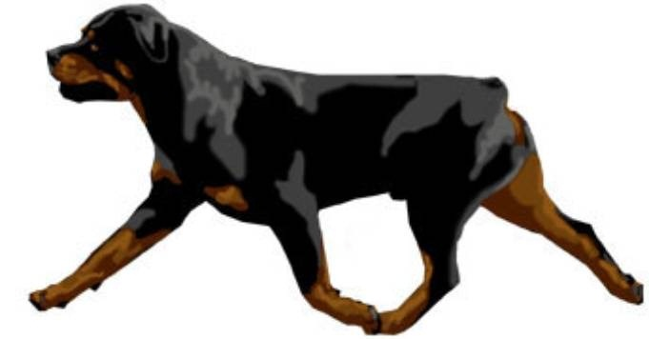
Strength, power, Balance

Slide 6
What Creates Balance in the Rottweiler?
Proportion
Front and rear angulation
Long Rib Cage and Short Loin
Conditioning

Slide 7
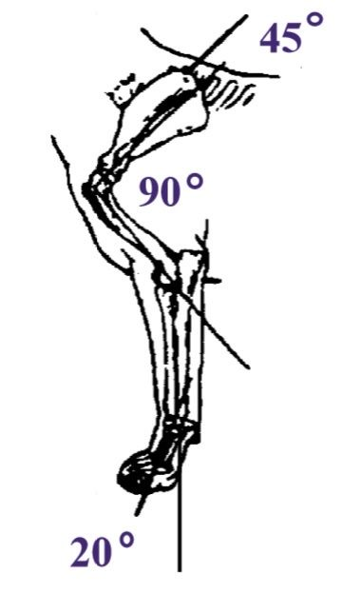
Front Assembly, Shoulder and Upper Arm

Slide 8
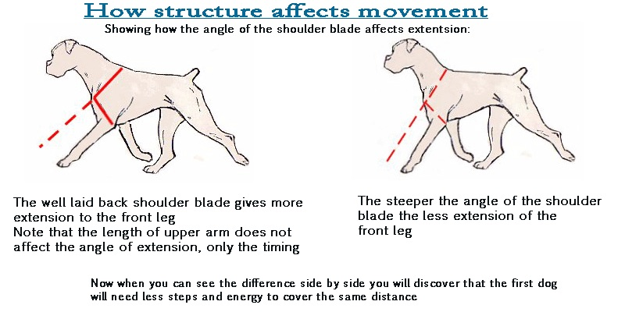

Slide 9
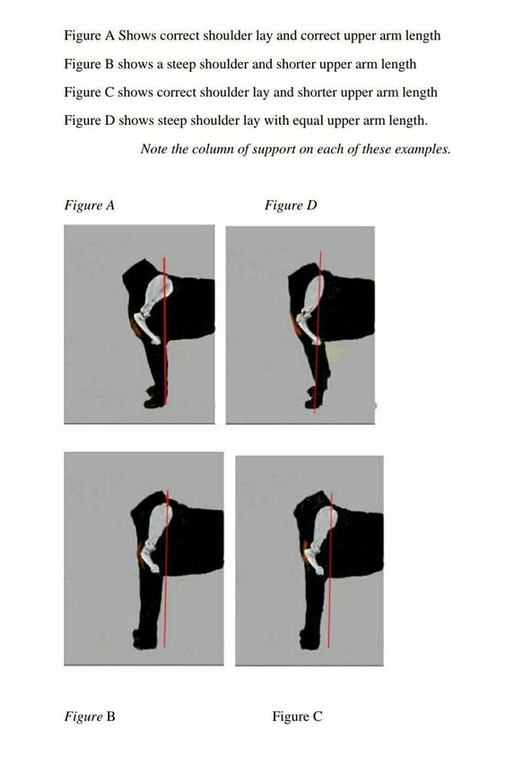

Slide 10
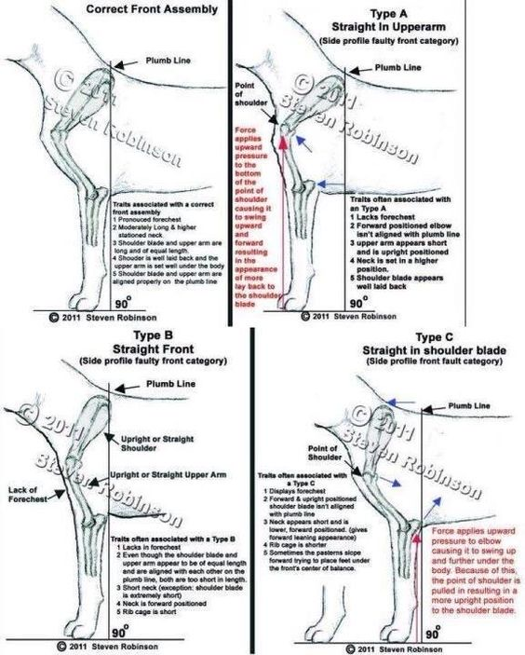

Slide 11
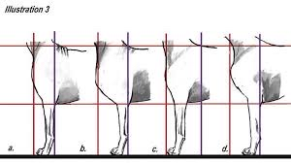
How Shoulders affect Motion

Slide 12
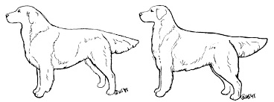
Good Layback means front legs need to be under the point of the Withers

Slide 13
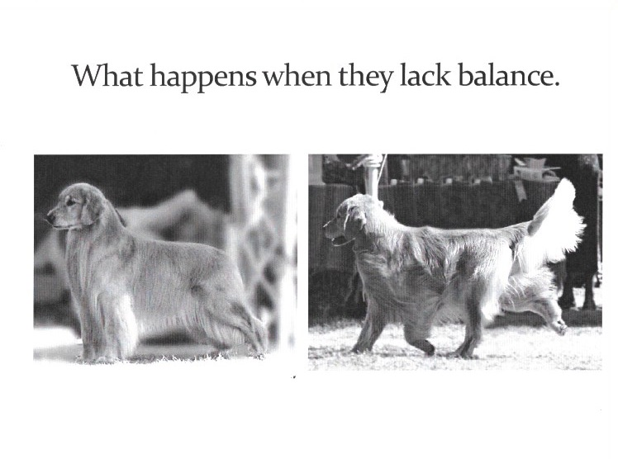

Slide 14
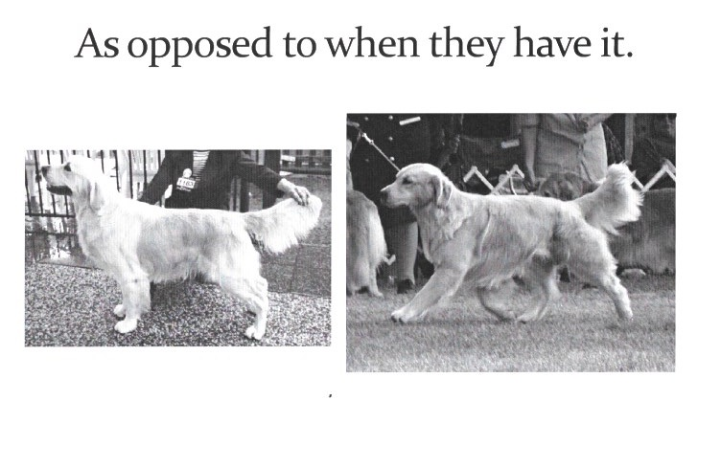

Slide 15
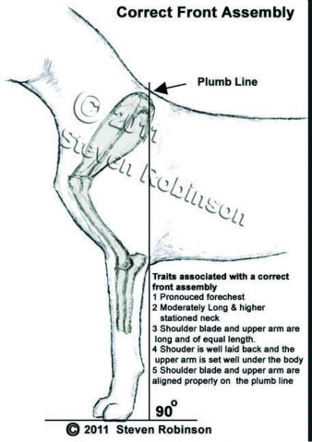
Correct Front Assembly

Slide 16
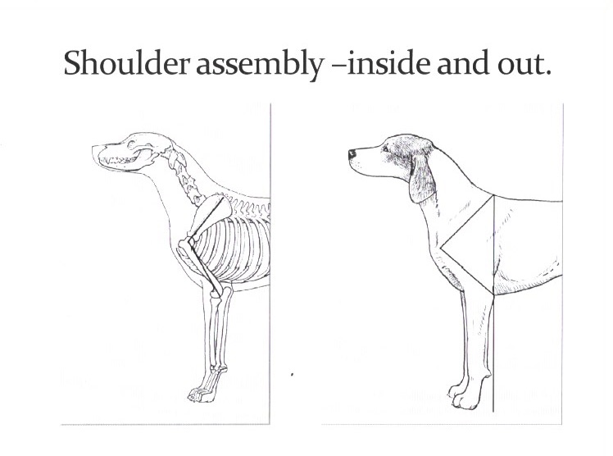

Slide 17
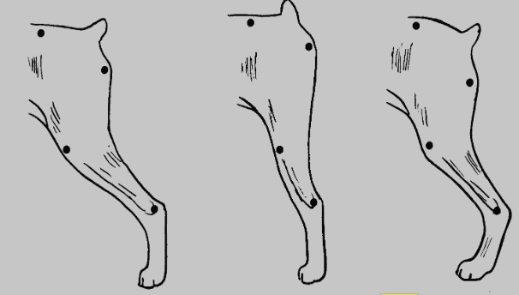
Rear End Assembly

Slide 18
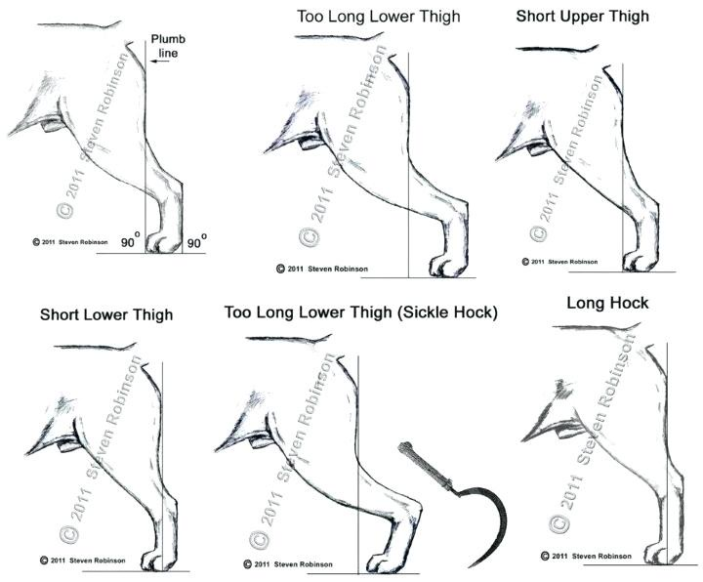

Slide 19
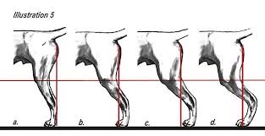
Rear End Assembly affects Drive

Slide 20
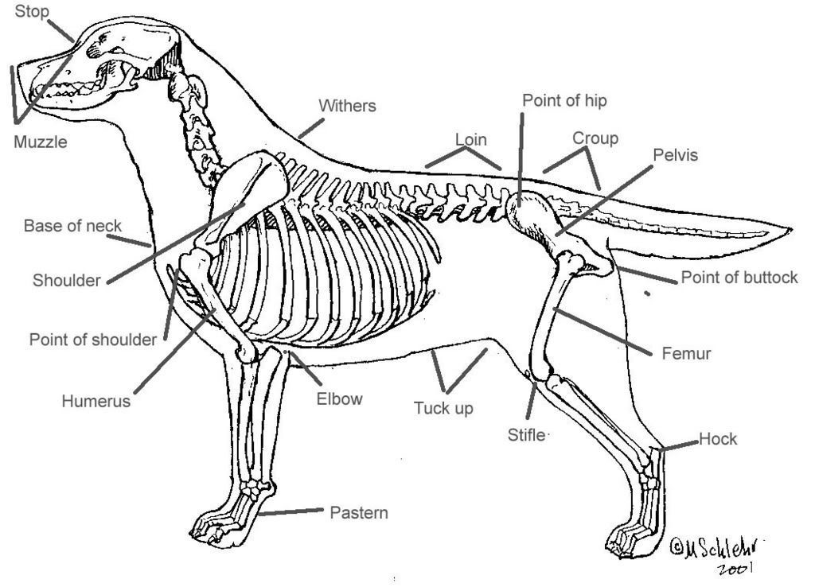

Slide 21
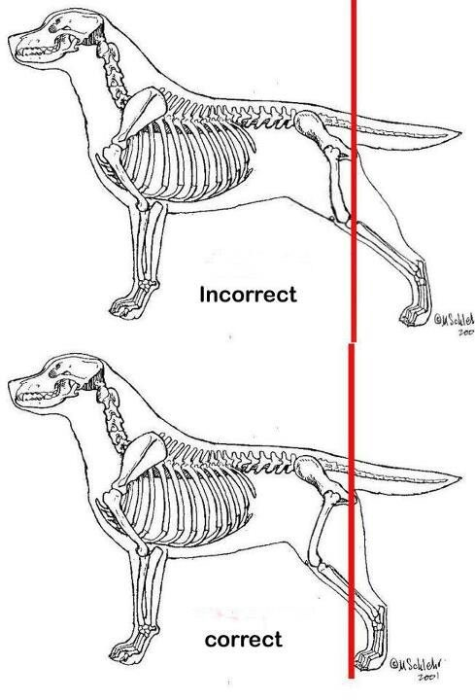

Slide 22
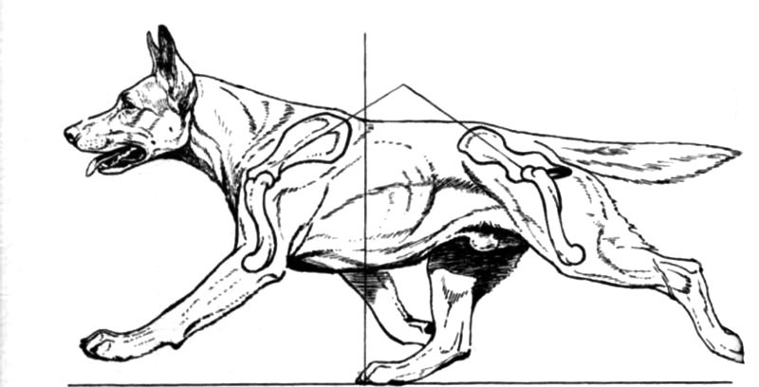
Over Extension, Flying Trot

Slide 23
A Balanced Front and Rear Assembly, WITH the correct proportion make for endurance
This gives the dog the most efficient, ground covering movement, with the least amount of effort
The result is an athletic, robust Rottweiler that in spite of the size, moves smoothly and without apparent Effort

Slide 24
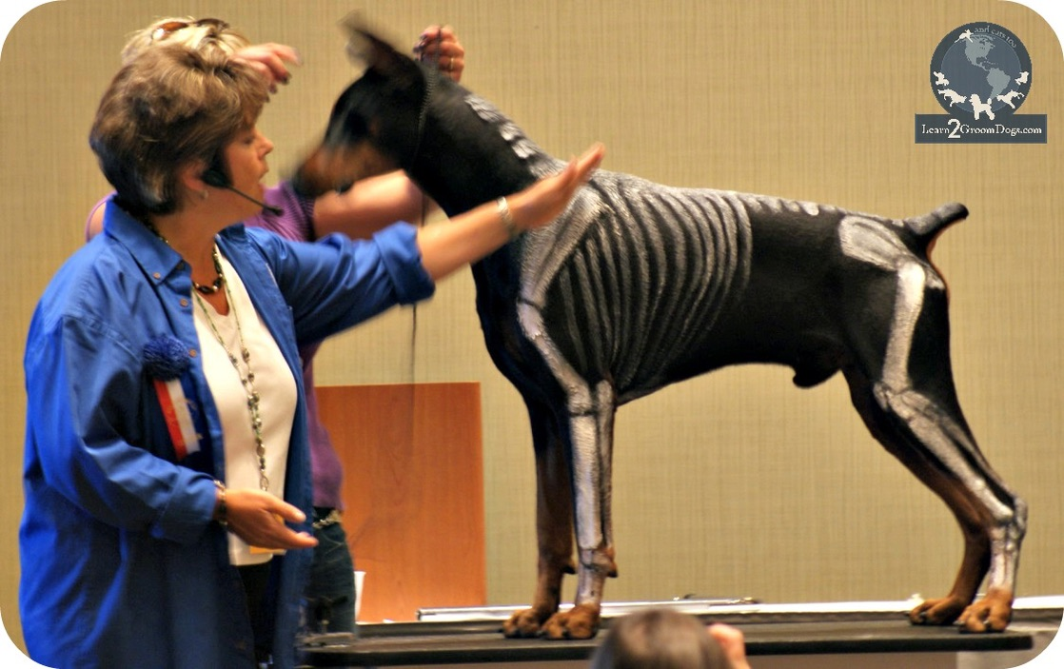

Slide 25
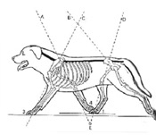

Slide 26
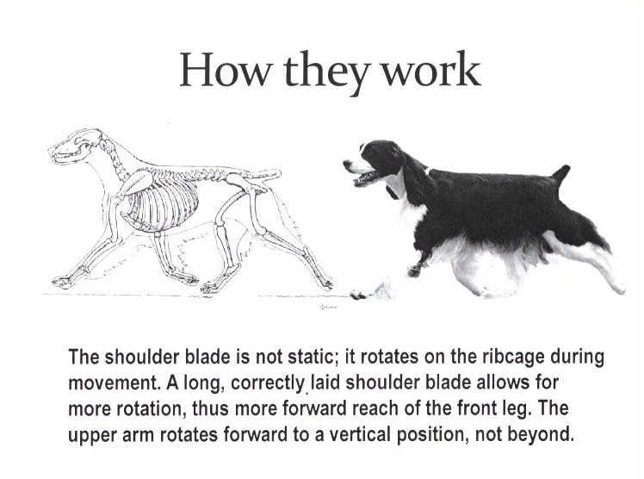

Slide 27
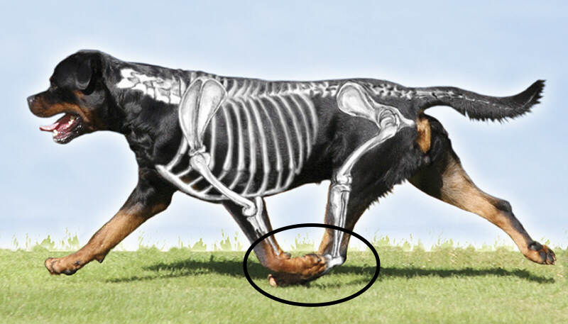

Slide 28
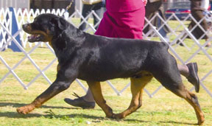
Balance

Slide 29
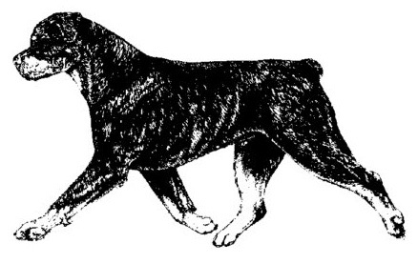
Balance
Harmony of design and proportion.

Slide 30
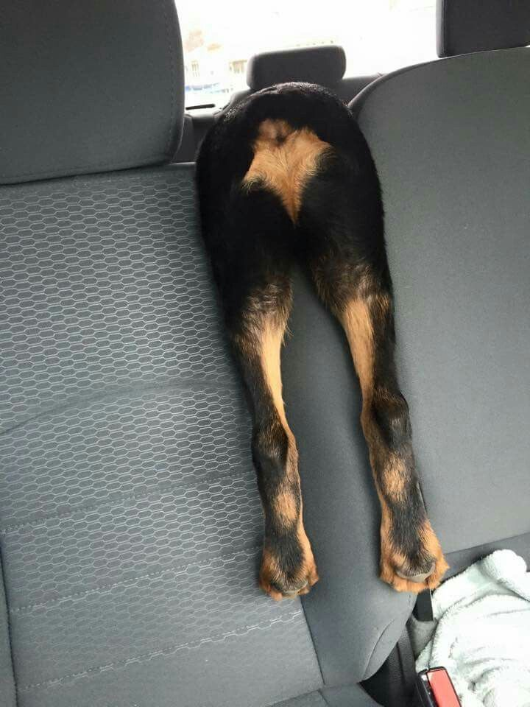
The End!

