Slide 1
Rottweiler Puppy Evaluation
Advice on evaluating your litter.

Slide 2
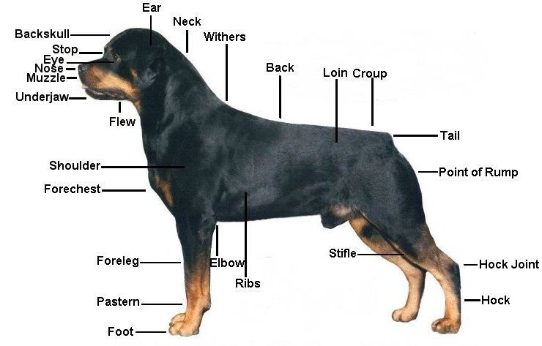
Rear pastern

Slide 3
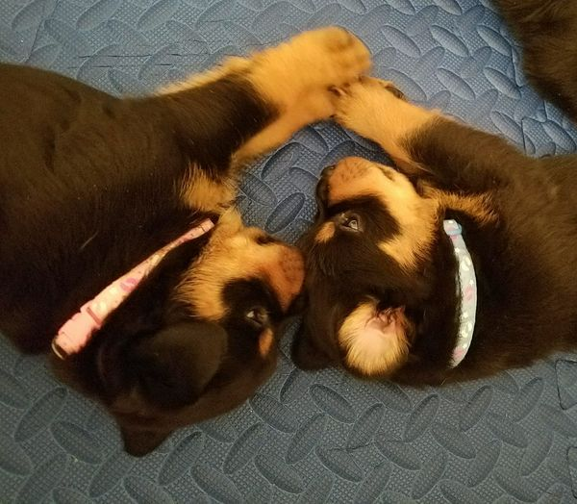
This is not a hobby It is late nights and early mornings. It is struggle. It is triumph. It pushes your boundaries and tests your abilities daily. One moment it exposes your weaknesses only to let you shine your brightest in the next. It is not for everyone. Heck, it’s hardly for anyone. But in that moment when all comes together, when man and beast are one. That moment is worth all the hard work and sacrifice. It is necessary as breath, as the blood in your veins. No, this is not a hobby. It is a way of life.
You had picked the stud dog.
The puppies were born!
Now the work begins on
Grading the litter:

Slide 4
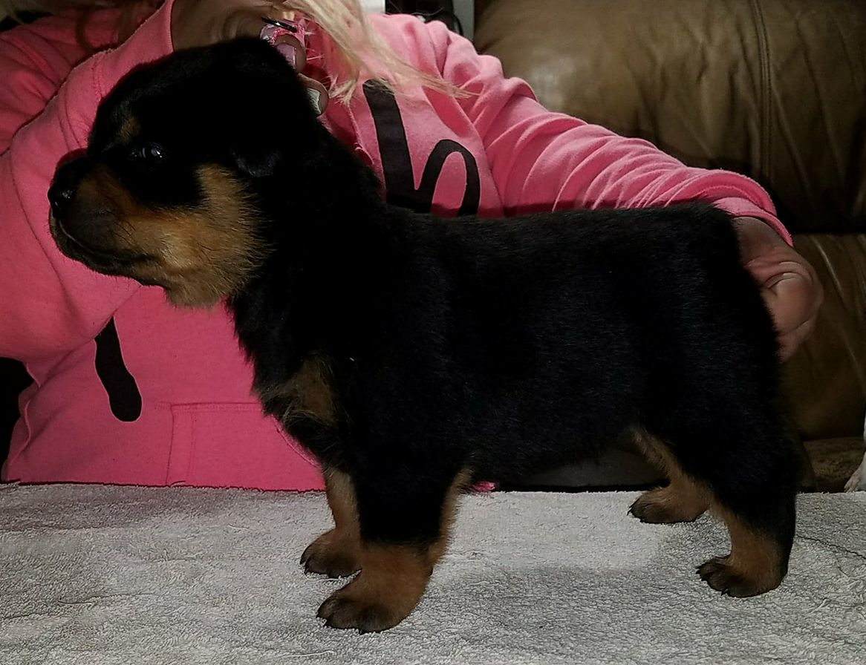
Do not evaluate the litter too soon. Many breeders concentrate too much on what they see at 3, 4, and 5 weeks of age.
However, It is good to watch behavior and temperament at 3, 4, and 5 weeks. See which ones are bold and pushy. Also, those that have a great general attitude.
4 weeks

Slide 5
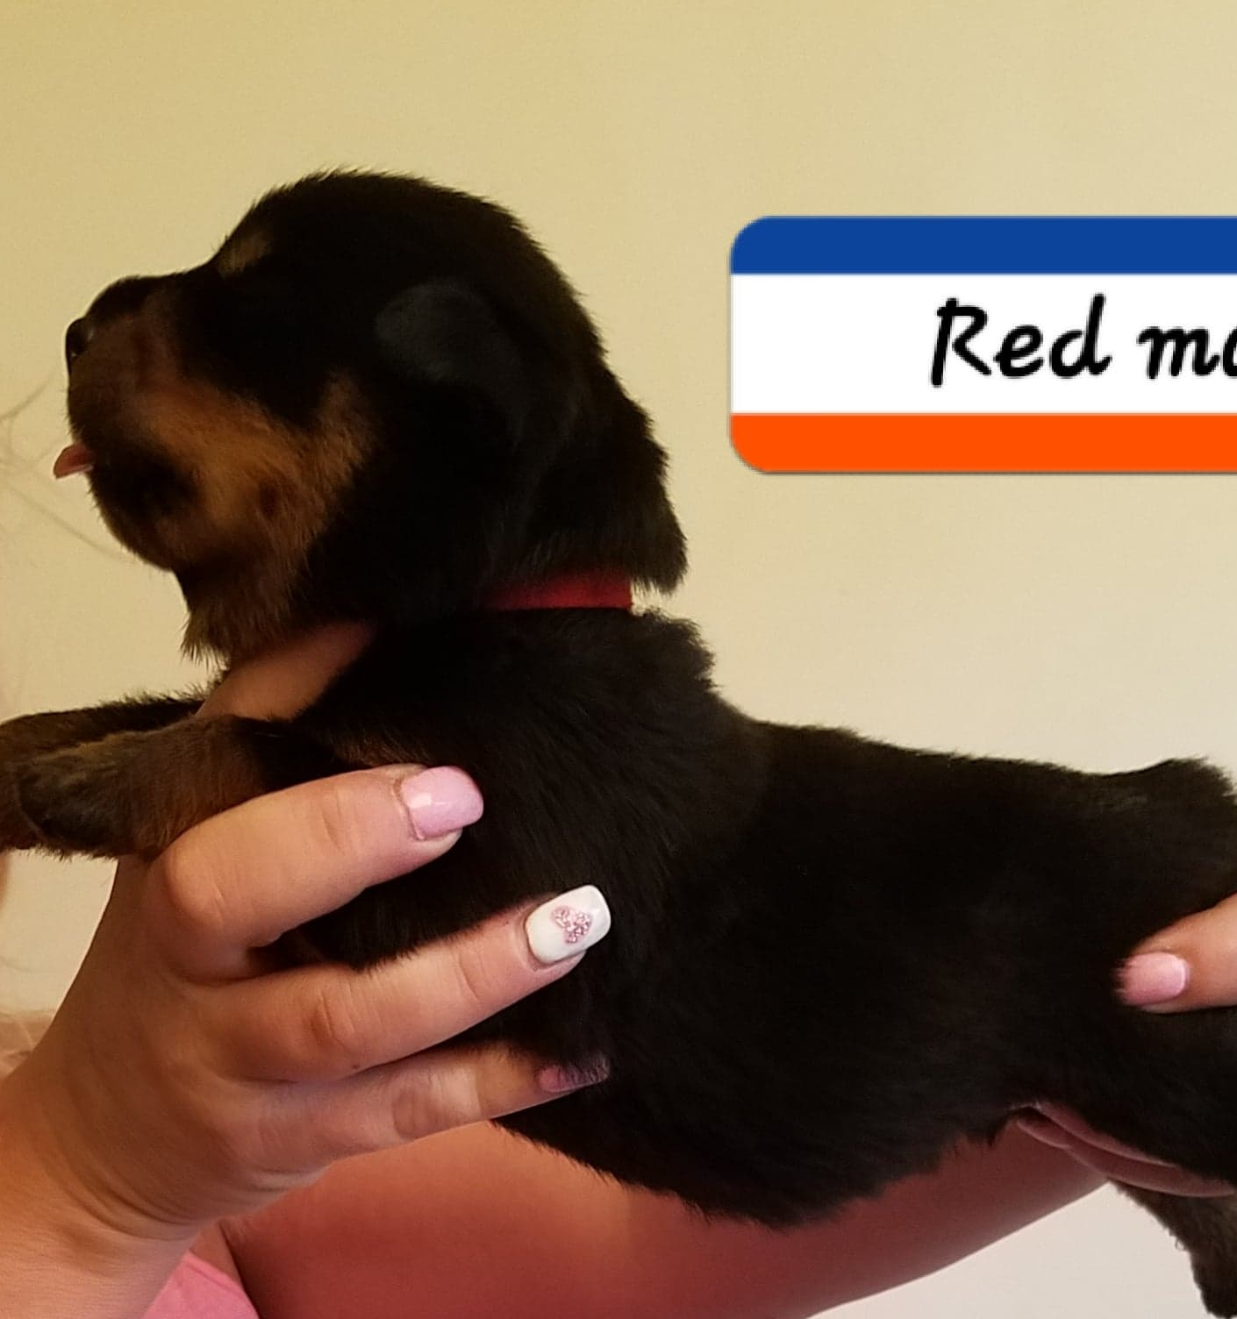
Incorrect!
You cannot evaluate a puppy by holding it in the air.

Slide 6
One of the first things you can do is observe the puppies moving around.
Take notice how they interact with each other.
If it’s a litter of 8 or more, view them all briefly, then divide them into a smaller group.
.

Slide 7
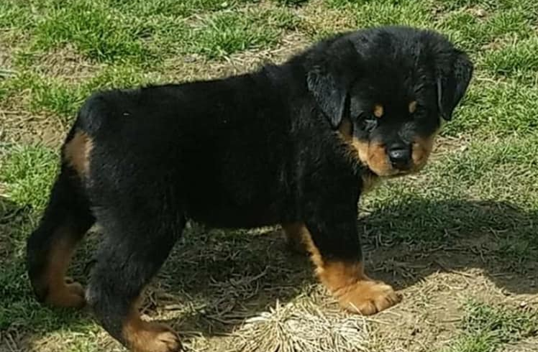
You are looking for the puppy that carries himself with style and attitude, also ones with their tail up…moving boldly around. Just sit somewhere in the room/yard, where you are out of the way, and are able see all puppies moving about. Try to get a general "feel" for which puppies "strike" you as outstanding and having great quality.

Slide 8
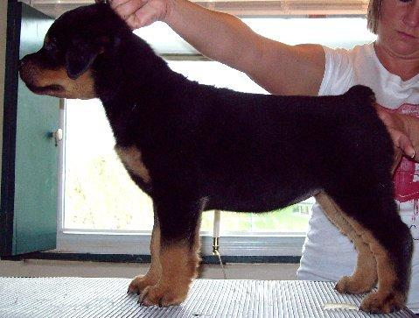
At 5- 6 weeks just concentrate on the puppies getting used to being up on the grooming table and relaxing up there. It is easier to evaluate a puppy that is used to being on a grooming table!
Try to get a realistic idea of what they look like stacked on the table.
Happy legs, are good for training the puppy to stand/stay. But NOT good for evaluating a litter! You are placing the feet, not necessarily where the puppy would place them naturally on their own, based on their structure.

Slide 9
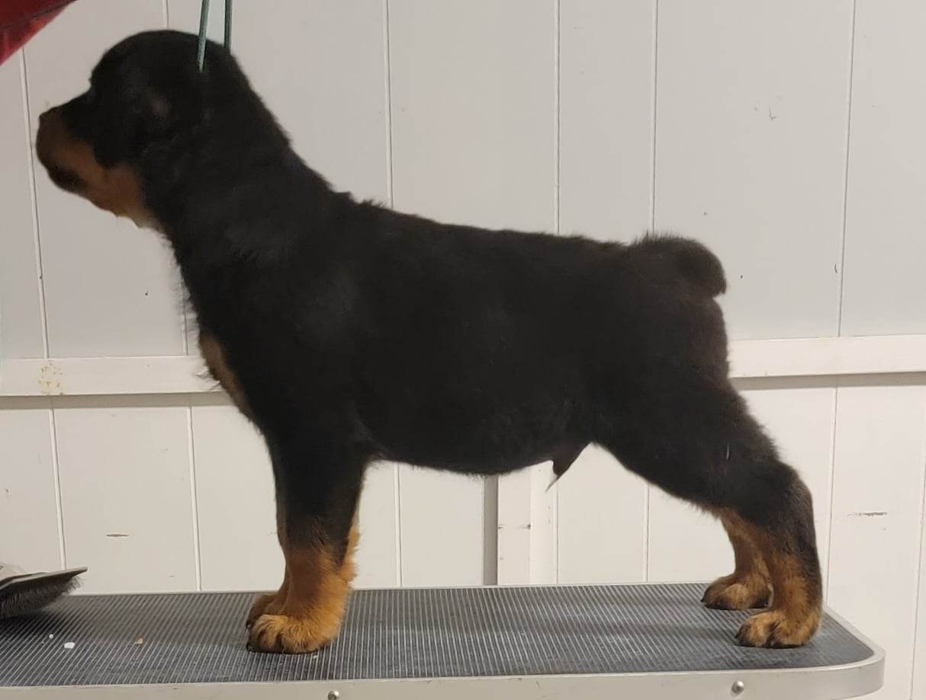
At 7 weeks, the puppies should be used to being on the grooming table.
Each puppy is put up on the grooming table…all collars and yarn removed. I like to use a show collar to hold the head in a correct position. You want to be able to see how the neck flows into the wither and look at the arch of neck. Remember that the lower jaw should be above the topline if the neck is of correct length.

Slide 10
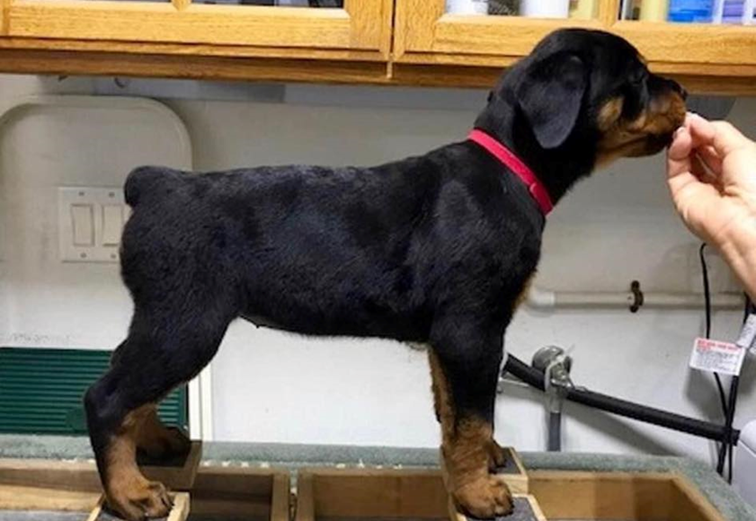
Look at the puppies at 7 weeks….and again at 8 weeks.
It is important to “picture” what a typical puppy looks like at these ages.
This is helpful when comparing size, bone, substance and maturity at these ages.
Also look for a puppy that stands square in a balanced position when they are attentive to something.

Slide 11
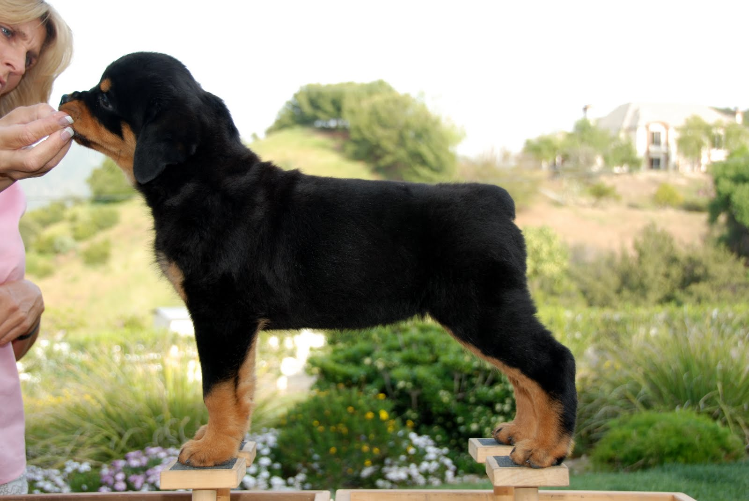
Once on the table you should be looking for:
Overall balance and harmony
A nice head
A smooth puppy overall. And for sure no wrinkles over the shoulder!
A dead level topline from the withers to the tail.
A tail that is "set on" right.
Look for the front assembly to be very angulated. Also note the length of the upper arm and placement. Straight upper arms, short upper arms or combination of both, are becoming a serious problem in our breed.
If the puppy is straight or shows the upper arm angle that is “just acceptable” as he becomes an adult---most often the upper arm will be straight once the puppy is mature.
The angulation (both front and rear assemblies) will get steeper in most blood lines. A few lines stay the same and even fewer seem to get more angles. But usually, 90 percent of the blood lines will lose angulation as they mature. So, look for front assemblies that are angulated properly—even to extreme, if possible. This is the one serious mistake most breeders make when evaluating puppies.

Slide 13
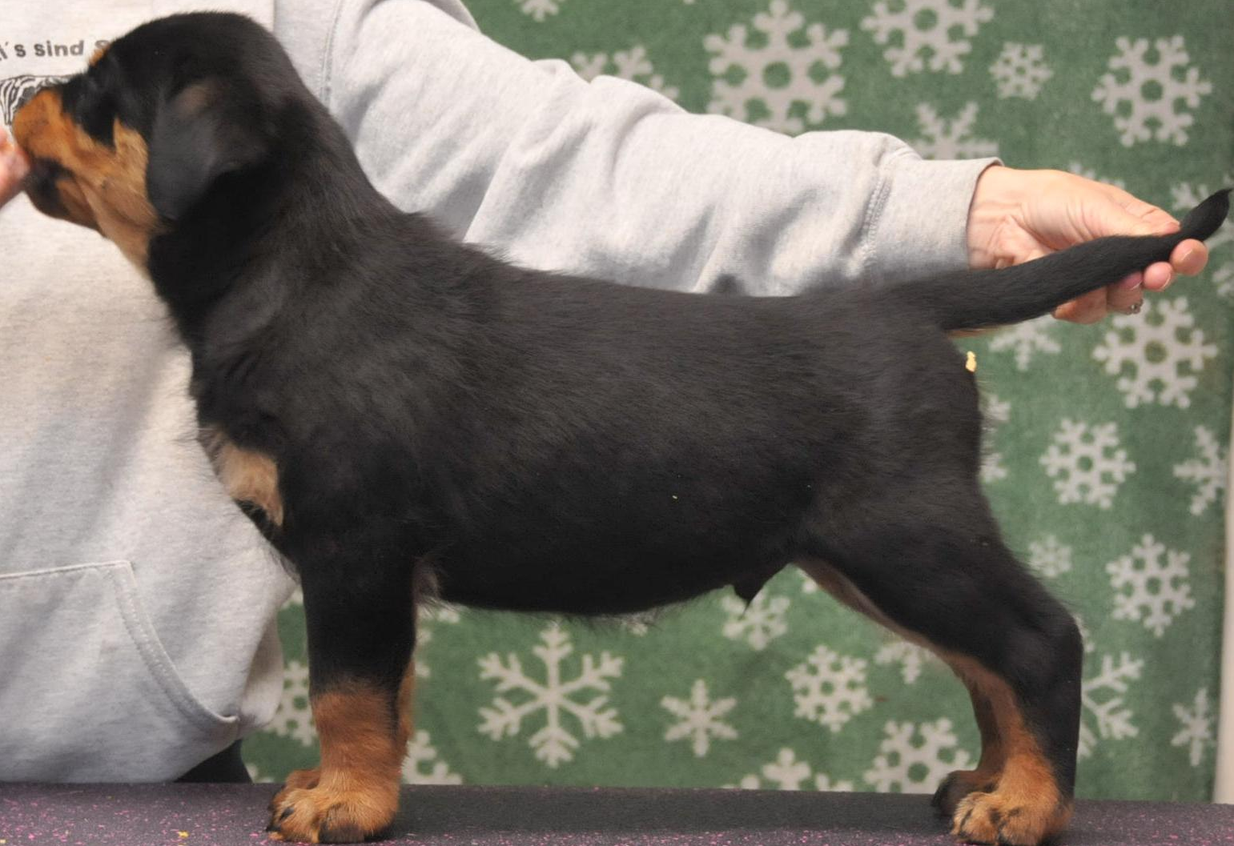
You should see a good width of chest and fill between the front legs. The elbows should hug the ribbing when standing and moving. This requires adequate angulation between the shoulder and upper arm as well as a good layback (angulation of the shoulder in relation to the horizontal ground) because without it, the shoulder assembly is positioned too far forward on the ribbing and the elbows will be pushed out by the wider, rounder ribs at the front of the chest.
In many puppies —they will have the depth of chest they will have as adults. As they grow to maturity, they may get a bit shallow, but it does come back to what they had at evaluation. In some lines, the chest may drop as the dog matures, however the ribbing should remain about the same.
Note distance between withers. Remember, when a puppy lowers his head, the shoulder blades move closer. There needs to be sufficient separation of the shoulder blades. Many measure by finger width…but it depends the width of your fingers.
In a well-angulated front assembly, the paws sit under the withers (the tops of the shoulder blade). If the paws are forward of the withers, so that they are closer to being under the neck, then the upper arm is too straight. If this section of the front sits incorrectly on the ribbing, the dog will have some gait defect when viewed from the front (coming at you) and generally will lack forechest.

Slide 14
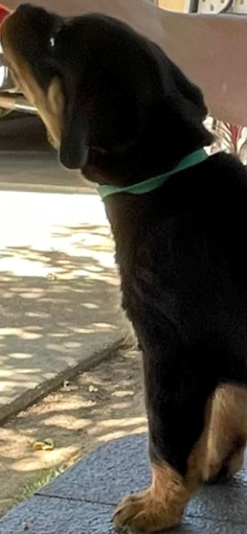
Front legs should always be behind the neck.
Straight front

Slide 15
The body should be deep—almost too deep if you were looking at an adult. The deep body makes the legs look too short.
But watch: when puppies are “tall” and leggy and not deep and full through the brisket. Also watch those, without depth and spring of rib that lack width through the loin---—often being taller than long, more slab sided instead of good spring of rib and proper loin development.
The front legs should be straight but may toe out slightly.
The elbows should lie close to the body. You should not be able to slip your hand between the body and elbow.
The brisket should be deep and “hanging” between the front legs. From the side the puppy should show beautiful rounded forechest—moderate is good.
If the puppy does not have forechest it signals that the front assembly is probably straight and too far forward.

Slide 16
Gently drop the rear in the same manner to see where the puppy naturally stands.
Puppies should not be cow-hocked or bow-legged from the rear.
Rear legs should be straight and true from the back view. Any deviation from the straight column of support wastes energy moving and puts stress on the joints over the lifetime of the dog.
The movement you see in a puppy will be reflected in the adult, so telling yourself that the puppy will outgrow faults like weak pasterns, cow hocks, out-at-the elbows, etc. is just wishful thinking.
The rear legs, from the side, should show a good bend of stifle .
Angulation should be obvious in the puppy because while the adult dog may end up with the same angulation the puppy has at this stage, they rarely will have more angulation. Dogs with a good bend to the stifle get more push with each stride making their movement is more efficient.
If you have a hard time seeing this, try holding the puppy upright with its rear feet on the table. If you can see the angle of the hock, that’s good. If you can’t, then the rear angulation is too straight.
Correct
You want to see a definite turn of stifle
Straight, no bend of stifle

Slide 17
Look for an overall balanced puppy: There are some puppies that fill the eye with a quality that is a result of the pleasing combination of all their parts.
These puppies are NOT evaluated by comments such as, “What a beautiful head”, “What great rear angulation”, “What great shoulder lay”.
Comments of this kind always suggest a puppy that is “out of balance” because one element of structure is overpowering of all else.
You want to be able to put the puppy on the table and say, “This is an even, balanced puppy”.

Slide 18
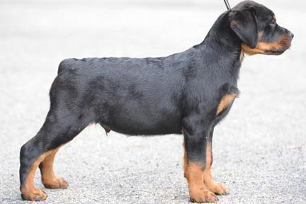
Balance Lines
BALANCE LINES AND PUPPIES
Using the balance lines, look for a pup with a good straight back, a pro-sternum line that dissects the body as closely to the middle as possible, make sure the neck is in front of a line drawn up the
front leg.
“By studying a picture, you can see how the balance lines can show just how badly out of balance a dog can be".
Balance lines work on puppies as well, specifically at seven- eight weeks of age. After that time pups tend to go through uneven growth stages which can throw the lines off until the dog matures.

Slide 19
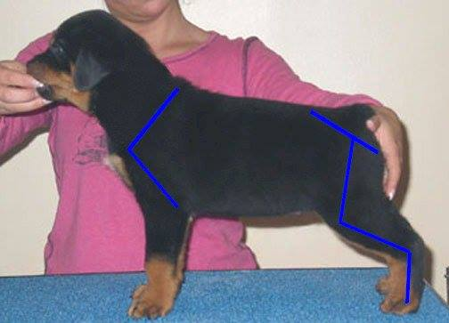

Slide 20
It takes a good eye to be able to grade your puppies. It takes practice and being able to watch other litters being graded.
A balanced puppy will become a balanced adult. All good puppies will have it. What does balance mean? If you look at a puppy, whether it is standing still or moving, no one part of the dog’s body stands out from the other parts. In other words, all the pup’s parts seem to be in proportion. Proportion in 7-week-old puppy is a good indicator of what they’ll be as adults.
Don’t try to over-analyze, just let your eye settle on the pup and see if something jumps out at you.
Rottweilers should be SLIGHTLY longer than tall and should have forechest, even at this age, and appear overall to be rectangular than square. (Short legs can make them look rectangular, so here again is a good reason to have an experienced eye help you.)

Slide 21
From 8 to 12 weeks, toplines remain true and probably represent what the dog will have as an adult.
Topline faults that are apparent at 8 weeks will persist in the adult to some degree.
Note length of rib cage and length of loin.
Dips or roached toplines are not desirable.
A puppy who displays a roached back (a back with an arch in it) will likely have a poor rear as an adult.
(Don't confuse an arch of back with an arch of loin! An arch in the back occurs over the rib vertebra.)

Slide 22
As one of the last areas to develop on a dog is the croup, which is formed by the pelvic bone and the muscles that overlay it. The tail set is influenced by the angle and length of the croup and is why it changes as the dog matures.
In 7- 8-week-old puppies, I don’t want to see much arch in the loin. I find that as pups mature and their loins get muscular and develop, the croup will take on the correct look. (Slightly sloping).
If I see a 7- 8-week-old pup who appears to have the correct "adult" look to their croup and tail set, they will have too low a tail set and possibly too much tilt to the croup as an adult.(A dog can have a correct croup and still have a tail set that is too low).
If you cannot see the tail set, here’s a trick: look for a slight "shelf" behind the tail set. The point just below and behind the tail base is the ischium / point of the buttocks/ end of the pelvic bone. If this is not clearly visible, the dog's tail set is too low.

Slide 23
The front legs should be straight as they leave the body and proceed to the pastern.
The rear assembly should be scrutinized just like the front.
The croup should be just ever so “slightly” sloped…almost unperceivable.
The tail set should be proper, with the puppy carrying the tail at 1 to 2 o’clock when moving around and happy. The croup should be approximately the same length as the ischium (the point of bone right beneath the tail) to the stifle and the same from the stifle to the hock.
The stifle should have A LOT of turn at this puppy age.
The pasterns should be short and perpendicular to the ground. REMEMBER most lines will LOSE angulation front and rear and will straighten some as they grow.
Therefore, it is important to look for more exaggerated angles in the puppy.
This is not to be confused with sickle hock, or longer lower thigh.
Remember: The hock is a joint. It has an angle but no length. So, when we talk about short/long hocks, what we’re really talking about is short/long pasterns.

Slide 24
I don’t like to see a puppy stand with its rear feet under itself - sometimes they will all stand like that - but some tend to naturally stand that way.
Hind feet almost directly under the stifle….. The shape of the leg from the pastern up looks like a farmer’s sickle. This is not to be confused with hocks that don’t flex, which is also called "sickle hocks". Some pups do this consistently and I find these usually have either an imbalance of the bone lengths in the leg or of angulation and they usually do not have a good, free gait when moving.
The angle at which the croup intersects the ground has a lot to do with how well the dog reaches under himself and how well the “follow- through" is. If the croup is too flat, the tail set is usually high, and the dog tends to kick up in the rear.
If it is too steep, the tail set is too low. The dog may reach under well but lack follow through.
Think of the rear leg as a pendulum, then, you want an equal swing to both sides of a vertical line that is perpendicular to the ground.

Slide 25
Pasterns
Slight sloping
Down in pastern
A “slight sloping pastern” is desirable to ensure that the dog’s joint doesn’t knuckle over on impact.
Bad pasterns can be inherited, but there may also be environmental factors: A bad diet and obesity can cause a dog’s pasterns to be "down in pastern".
In developing puppies, teething and trauma may also come into play. Puppies raised on concrete surface or who aren’t getting enough exercise can be also be susceptible to pastern issues.
East-west pasterns can be created by nutrition, and not genetics. To determine the cause, pick up the front leg at the elbow. If the leg is turned when hanging free, the cause is genetic.
If the leg is straight when hanging free but turned when bearing weight, then the cause is most likely nutrition received during growth.
East west pasterns can also be a temporary issue during growth stages particularly during the “teenage” phase. This is one of the few structural issues that a young dog may outgrow.

Slide 26
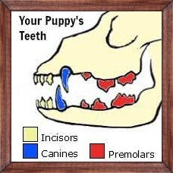
Dentition
“Puppy teeth erupt starting at about 2 weeks of age, and are usually completely in by about 8-10 weeks old, (28 puppy teeth)
Look for a good scissor bite. Remember to advise new owners to keep an eye out for retained puppy teeth.
An undershot bite will not correct!

Slide 27
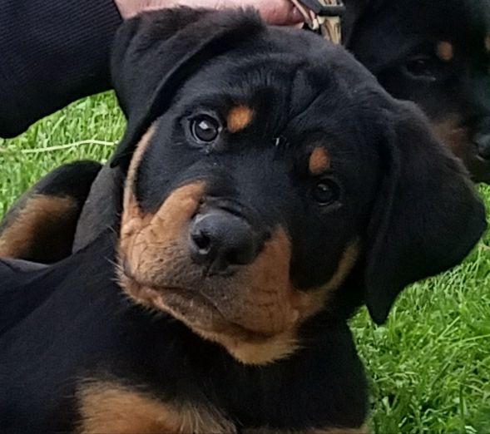
Eye color
Puppies’ eyes typically change color from blue to the final color at the 9 to 12-week point in their development.
Look for almond shaped, dark brown eyes.

Slide 28
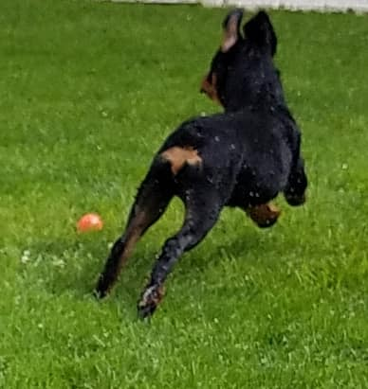
As for movement, until the puppies are older, their true movement may be difficult to assess.
For one thing, they are rarely leash broke enough for anyone to have a good look at them moving!
Again, sitting in the yard with them, watching them move around will often tell new breeders which ones will NOT move well.
The more you study and compare your pups at a young age versus adult, the better you will get.

Slide 29
Any puppy that toes in will be graded “PET”
Toeing in is very faulty in a young puppy.
If it toes out ever so slightly, it will often correct itself as the body widens and the puppy matures, as the elbows will be pushed our slightly and this in turn allows the front legs to correct and straighten.
Hocks that turn in (cow hocked) or out to any extent will probably remain and get worse as the puppy matures.
Any deviation that is pronounced at this age will be magnified as the puppy gets older.

Slide 30
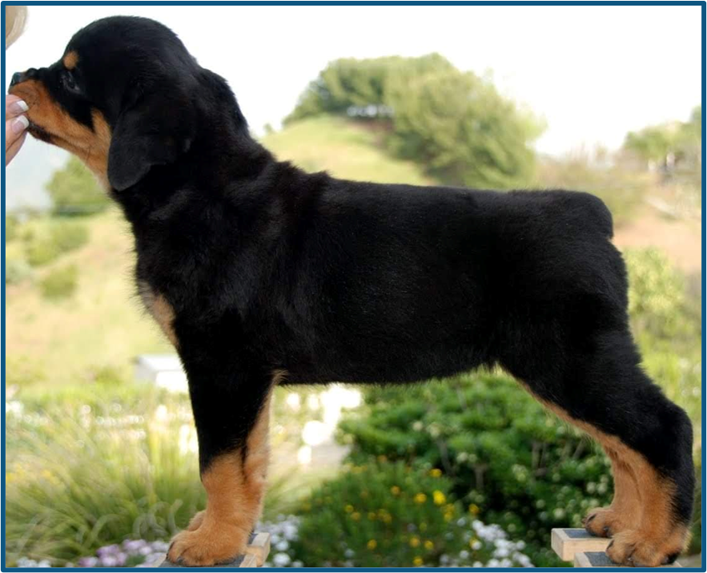
Jaw line above topline
Level topline
Note
forechest
Depth of chest
Feet facing forward

Slide 31
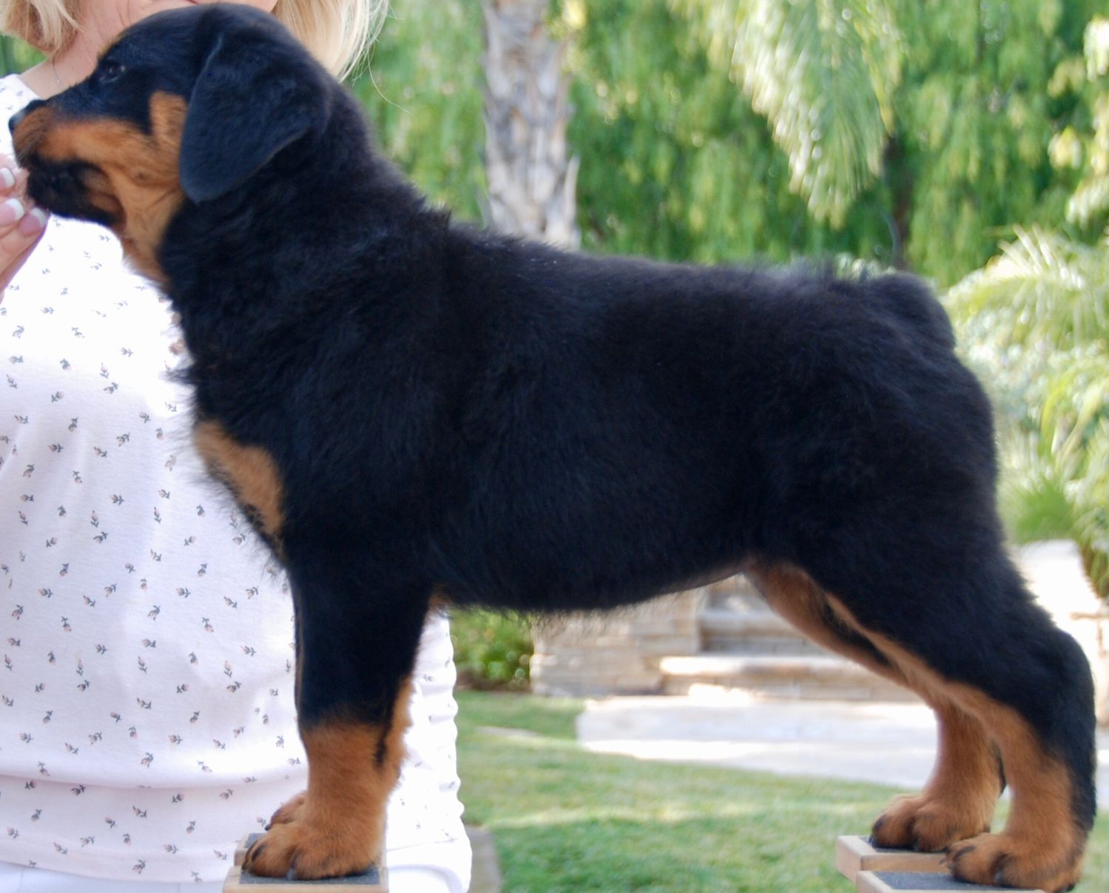
Remember:
Forequarter Angulation Affected by:
Placement of shoulder/lay back of shoulder.
Well placed/well laid-back shoulders: Good length of neck, maximum support for the elbows by the chest. Prosternum visible from the side slightly forwards of point of shoulders.
Medium length of neck, good to reasonable support for the elbows. Prosternum level with point of shoulders.
--------------------------------------------------------------------------------------
A forward placed results in a steep Short neck, lack of prosternum – prosternum hidden behind point of shoulder. Results in loss of support for the elbows by the chest = loose elbows, increasing instability of front assembly at speed

Slide 32
Remember:
Hindquarter Angulation
Angulation of the hindquarter usually refers to the relative lengths of the upper and lower thigh, length of hock and the resultant turn of stifle.
Balance comes from equal lengths of upper and lower thigh.
Stability - comes with short strong hocks combined with equal lengths of upper and lower thigh.
Instability comes from increasing length of lower thigh in relation to upper thigh.
Croup – length and lay of croup affects the transmission of power forwards.
Good angulation – equal lengths of upper to lower thigh, ideally with short strong hocks, good turn of stifle.

Slide 33
HEAD
The head really is the last thing to develop and may even grow into the dog's fourth year.
Dogs who have an adult looking head as an 8–12- month-old will have a head that continues to grow and as adults may be too massive.
Feel for the bumps on top of the pup's heads. Conversely, if you have a young dog with a relatively smooth head, it's not likely to fill out much more.

Slide 34
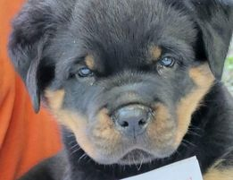
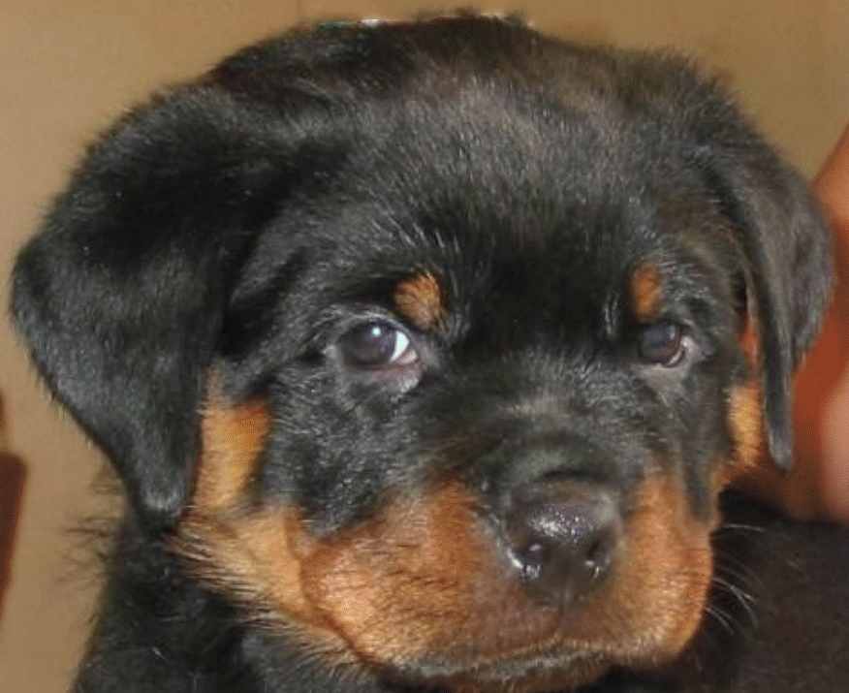
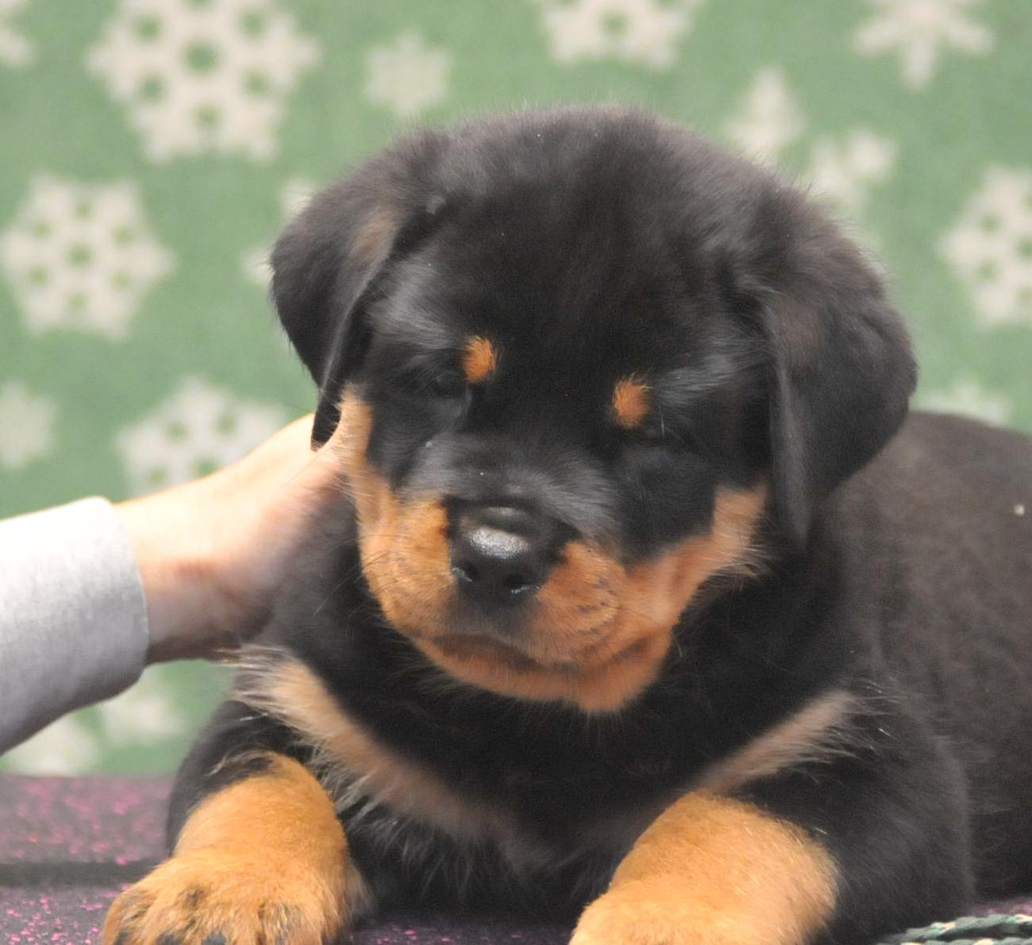
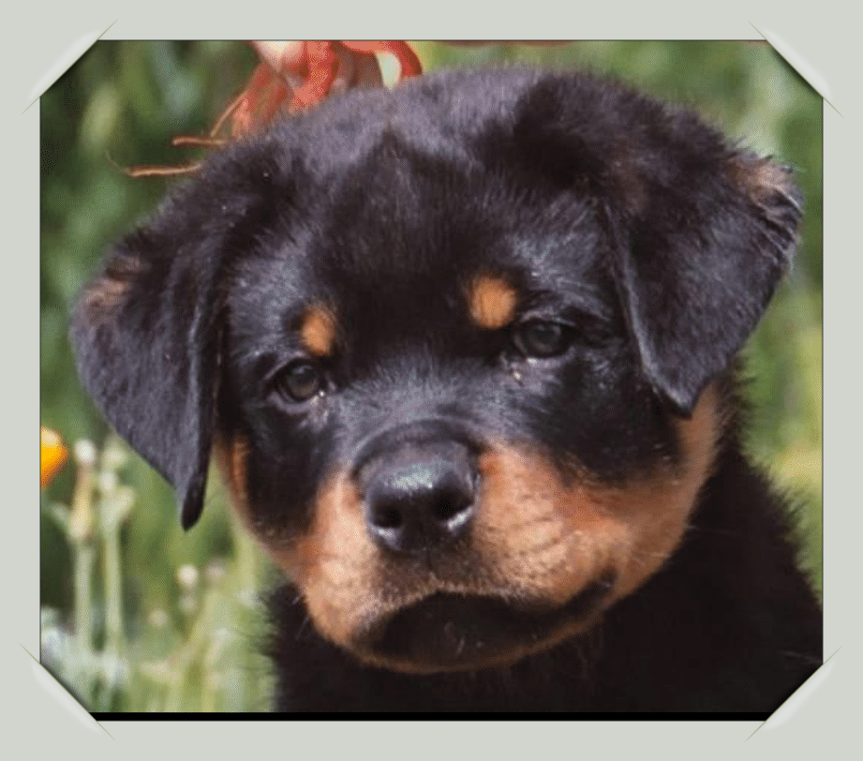
Puppy Heads
When evaluating heads, take note of ear set, underjaw, eye shape and color. Also, cheek fill and broadness of muzzle.

Slide 35
8week
6mth
20mth
2yr

Slide 36
Estimating size is an important ability.
Puppies offer many clues, beginning with the length of the pastern and the size of the feet.
In puppies, the pastern comprises a disproportionate amount of the total leg length. The longer it is the longer the leg will be. Feet, ears, and tails grow to adult length before anything else, so they, too, are indicators of future size. .
Bones do not grow along their entire length but from the ends. As the body prepares for this growth to occur, the plates at the end are enlarged. This degree of this enlargement can give you some idea of the dog's eventual size and whether growth will continue. Of course, the most obvious site in the puppy is the wrist, just above the pastern. Puppies that are going to be very large have huge knobs here and may even look deformed. As the dog grows, these reduce in size and flatten.
Size
Just because a puppy is the largest in the litter or weighs the most—does not mean as an adult it will be the largest!!

Slide 37
Pictures
I like using a photo to help assess the pups….as the saying goes “the camera never lies".
You can often see faults clearer, for one, the pups are "frozen" in the photo, and you have all the time in the world to study the angles of that real squirming, wiggling puppy.
For instance, you can study the relationship of the shoulder to where the legs and feet fall in a photo. This may often tell you more about adult movement than trying to see it in a moving puppy!
You’ll need a good photographer with an eye for the right angle and moment!

Slide 38
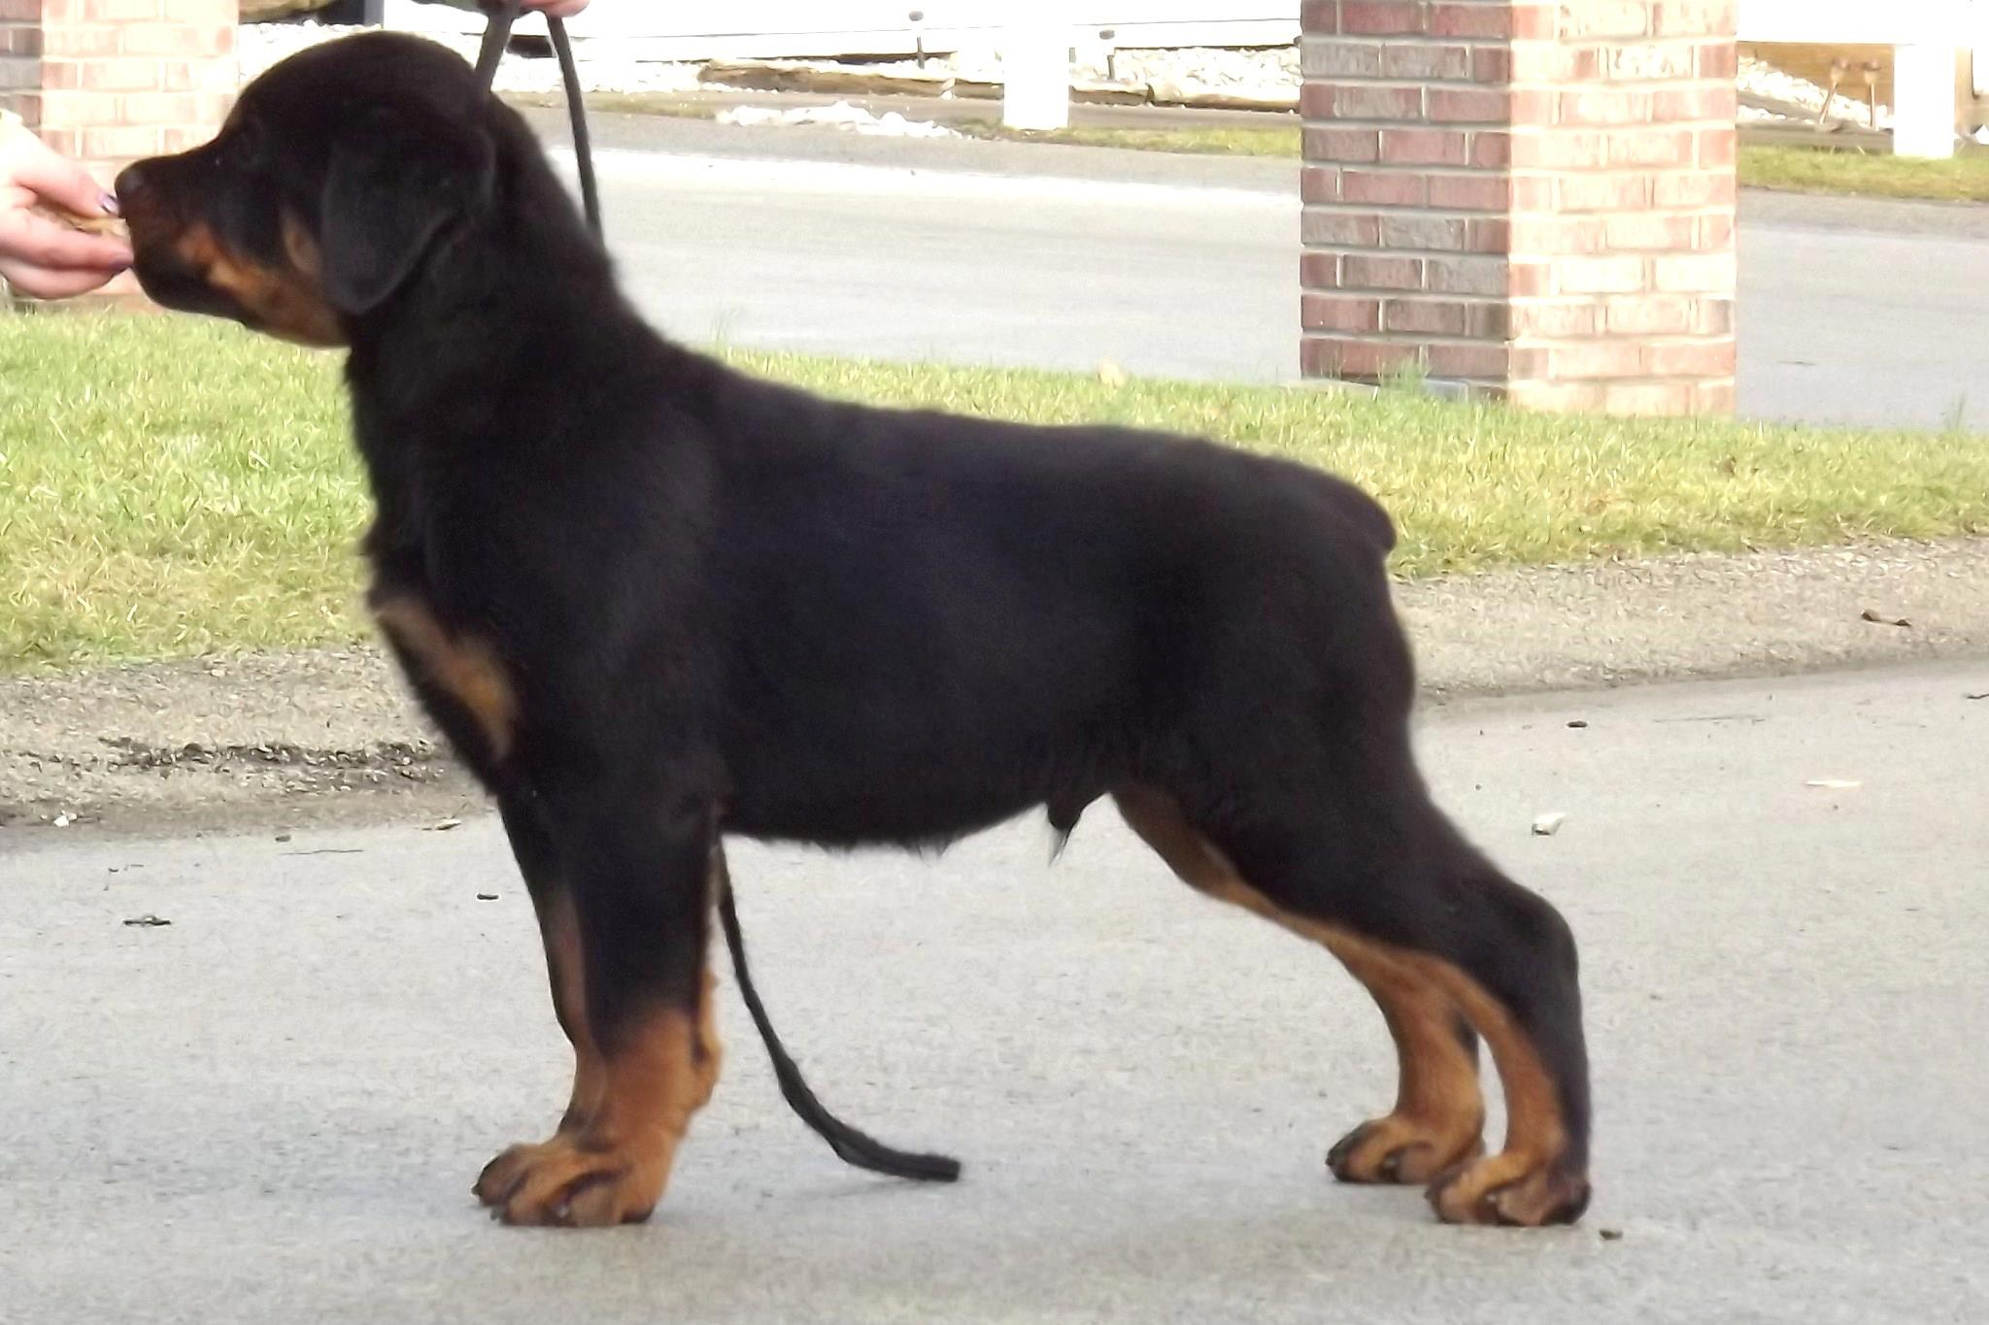
Mentally go over this puppy as if grading it

Slide 39
In a litter of 6 to 8, out of 2 outstanding parents and well bred
You may get 1 that conforms to this scrutiny that would be considered a “Top Show Prospect”!!
There may be 2 or 3 that are “Possible” show prospects.
You should not sell any puppy as a show prospect that you would not buy yourself.
Too many people either do not know what they are looking at and refuse to ask other experienced breeders to grade their litters for them.
Why ask an opinion from someone who hasn’t been where you want to be in your breeding program.

Slide 40
The breeder must always keep in mind that there is no perfect dog, and that all dogs have faults.
As stated in this slide show:
There are things that may change as the puppy grows,
There are things that may get worse as the puppy grows
There are also things that will stay about the same
Following will be the same dog at different age groups: YOU BE THE JUDGE! What changed? What did not change?

Slide 41
8 Weeks
2 years

Slide 42
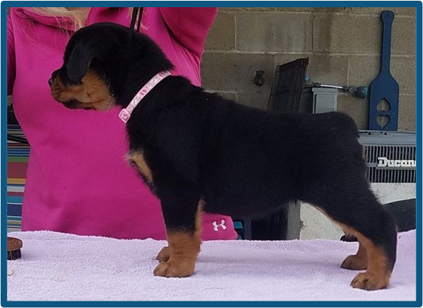
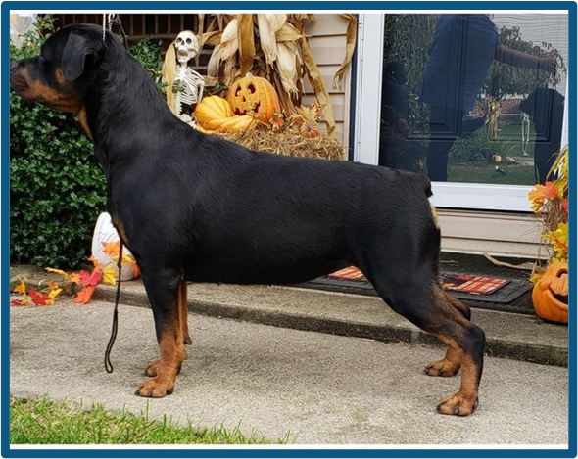
7 weeks
15 month

Slide 43
4 month
2 year

Slide 44
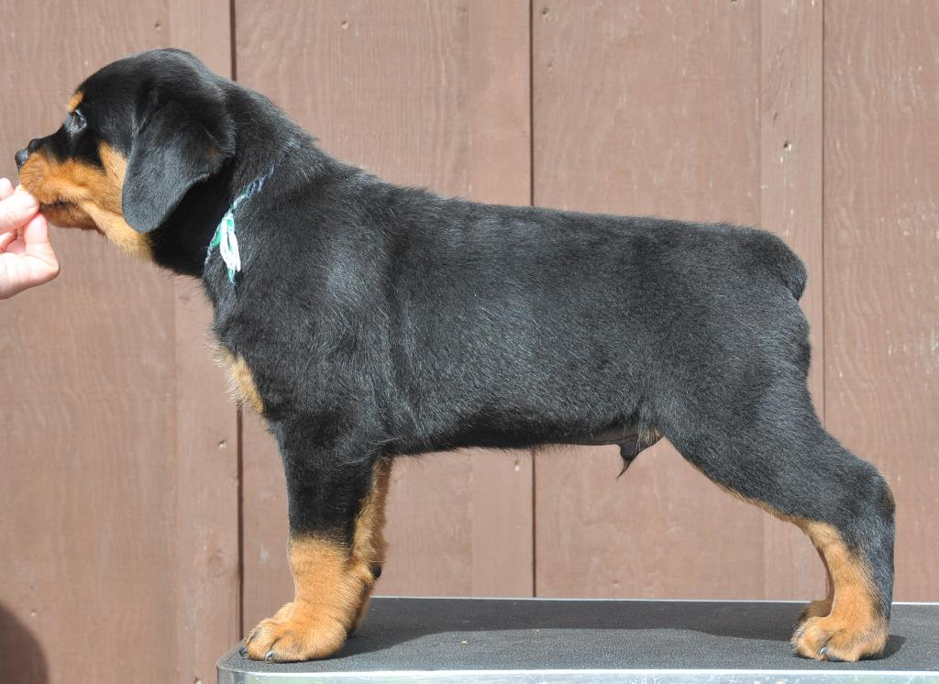
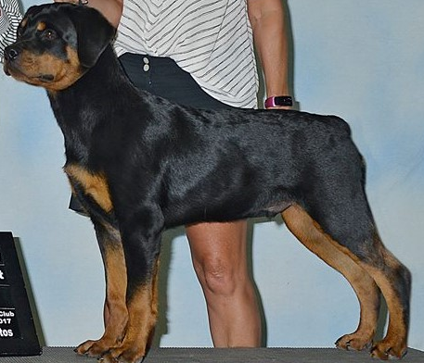
8 weeks
5 months
8.5months
11 months
5 years

Slide 45
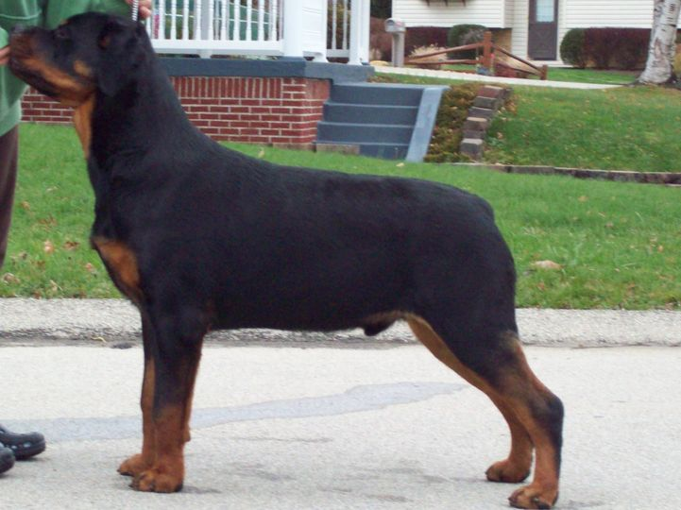
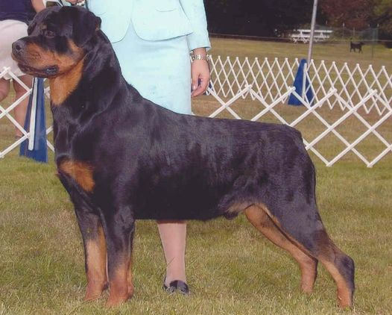
8 months
2 year

Slide 46
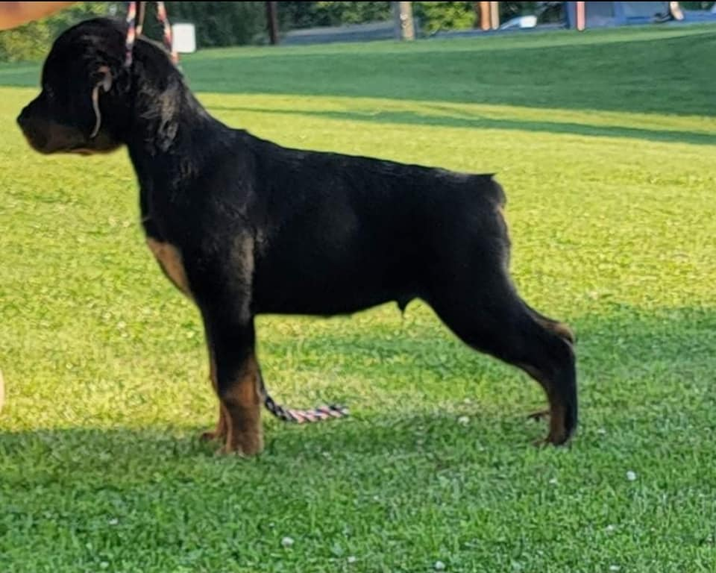
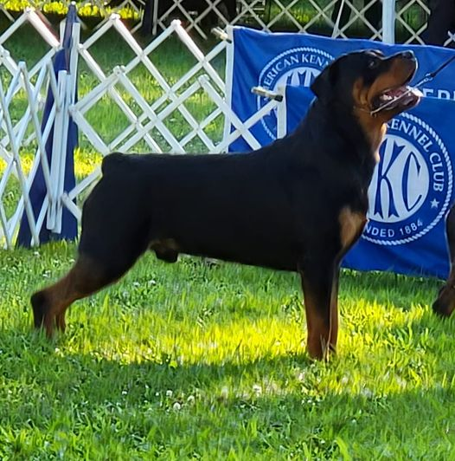
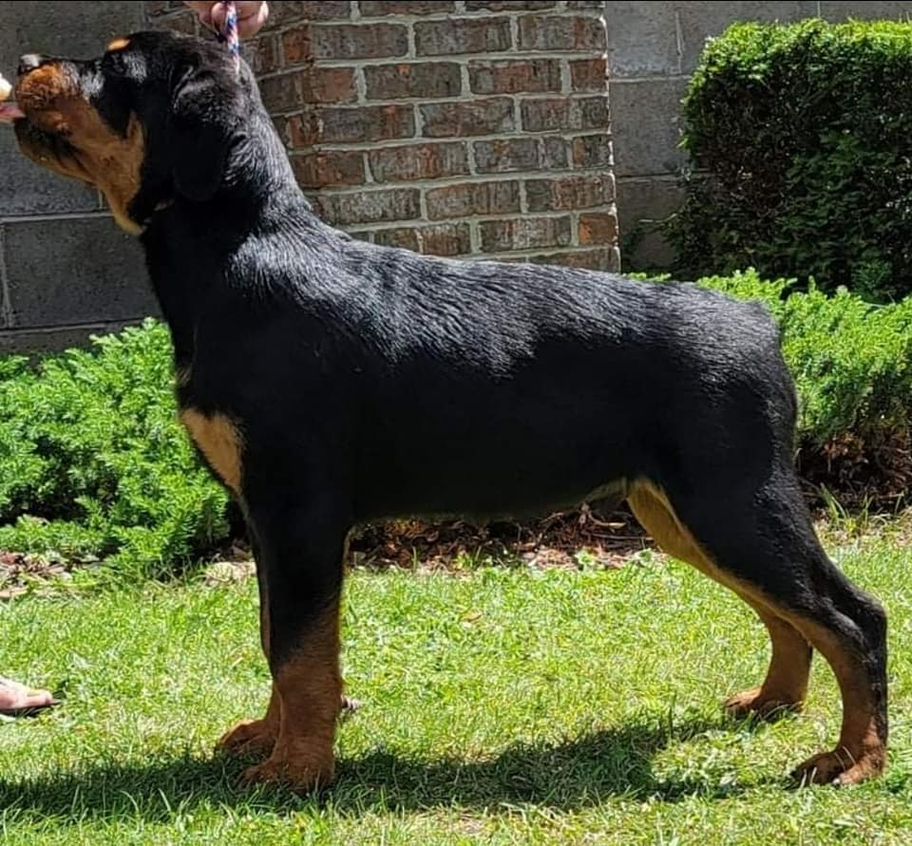
9 weeks
16 month
4 month

Slide 47
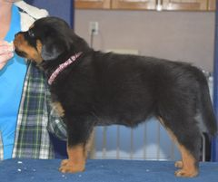
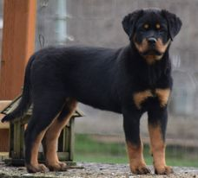
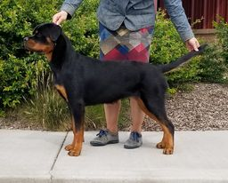
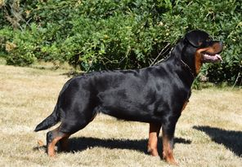
8 week
6 month
4month
3 years
1-1.5 year

Slide 48
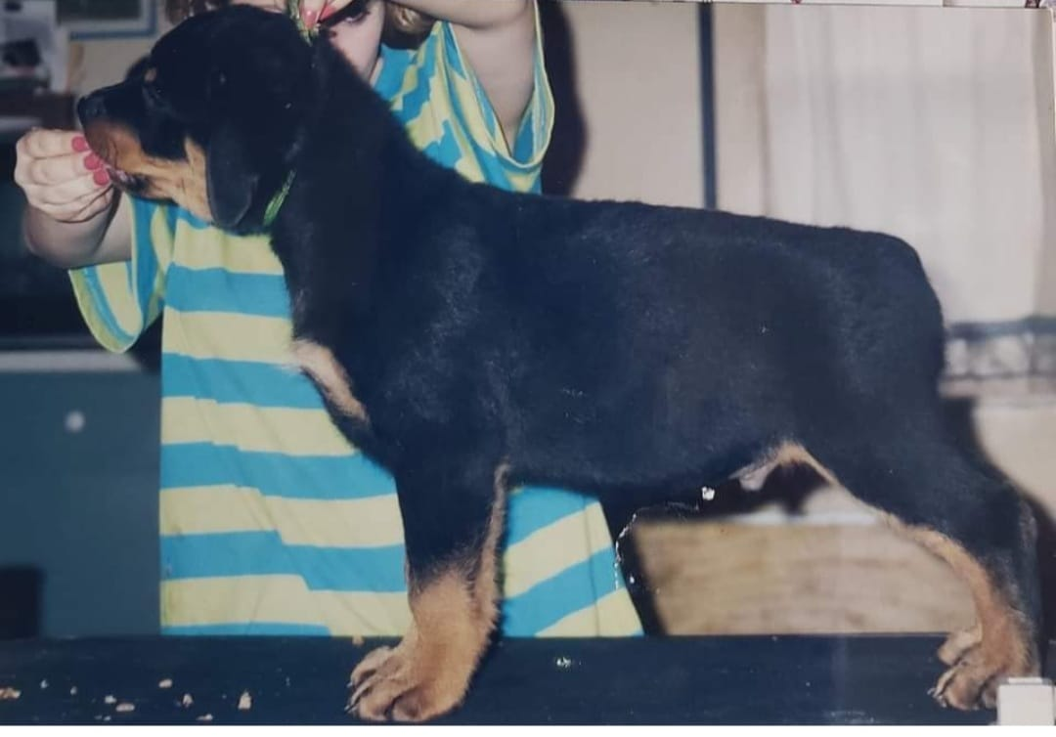
7 weeks
6months
2 years

Slide 49
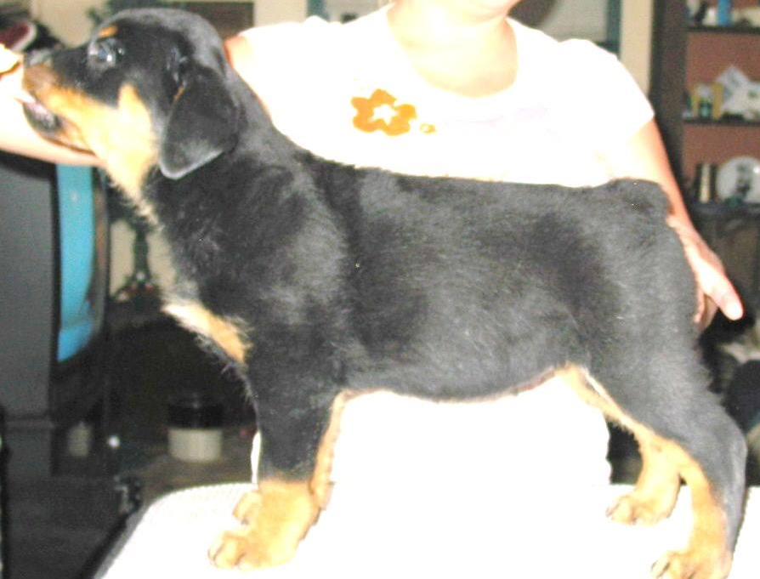
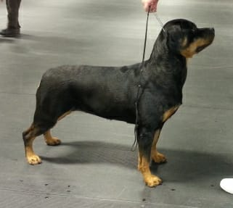
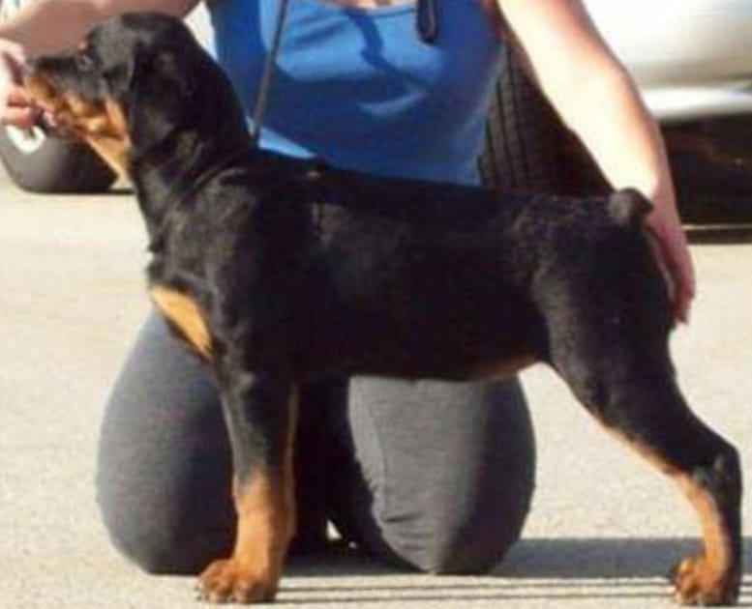
7weeks
2 years
4months

Slide 50
Sentimentality is the downfall of breeders. It causes breeders to make poor decisions and rationalize their decisions. Be honest with yourself and your litter.
Don’t BE Sentimental!!!
Be critical
Be brutal
Don’t be sentimental
Be realistic when grading puppies!

Slide 51
Elaine Starry
2022
resource: “Selecting Conformation Puppies”
Theresa Mullen
Terrylane Dobermans
EPS
C

