Slide 1
Welcome to the Rottweiler Education Seminar
“A Study of Rottweiler Movement”
EPS
2022

Slide 2
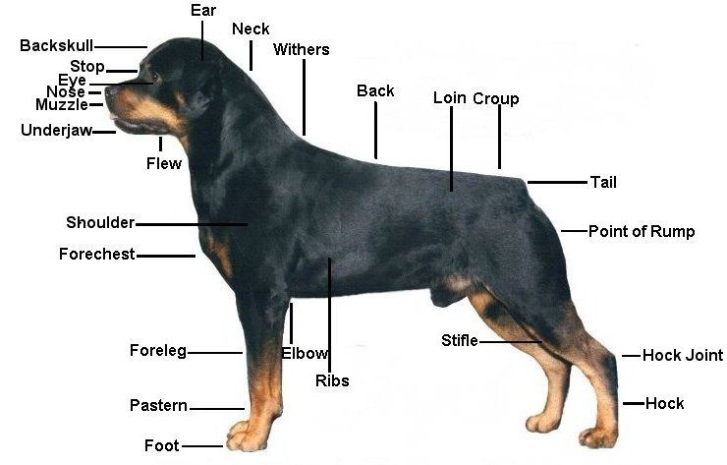
Rear pastern

Slide 3
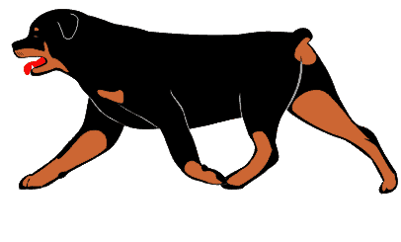
In the show ring the Rottweiler is judged at a trot, because this gait reveals most efficiency how he uses all his joints and controls his limbs and body.
Some will exhibit a smoothness and accuracy, an athleticism. These dogs may appear to move effortlessly.
Every breeder dreams of achieving these characteristics in his dogs.

Slide 4
There are principles that apply to the gait of all dogs, no matter what the apparent variations in their build.
In moving, any animal attempts to conserve as much energy as possible for that speed.
In order to do this, he must move his center of gravity as little as possible.

Slide 5
Rottweiler Gait
You should get the same impression of the dog when it’s standing or moving
In a normal pose and when gaiting, the elbows lie close to the brisket—look at the dog from the back, and you should be able to see the elbow fit tightly into the brisket.
There should be no air space between the elbow and body. If you can see through the area or it looks like you can get a hand in there, the lay on is not correct and the dog will probably stand wide, move wide or toe in thus not gait properly.

Slide 6
Rottweiler Gait
The real test of a dog’s structure is his gait
If we must sometimes make compromises when we breed, we must value correct and efficient side gait (which is not to be confused with fastest gait).

Slide 7
Gait
To understand gait, it is important to study all breeds of dogs
There are 3 basic types of movement
1. Movement coming
2. Movement going
3. Side movement
All 3 are equally important.
A correctly moving dog shows correct movement from all angles.

Slide 8
The topline should remain level while the dog is in motion without evidence of bouncing or rolling from side to side.
The back should not sag, sway, or roach.

Slide 9
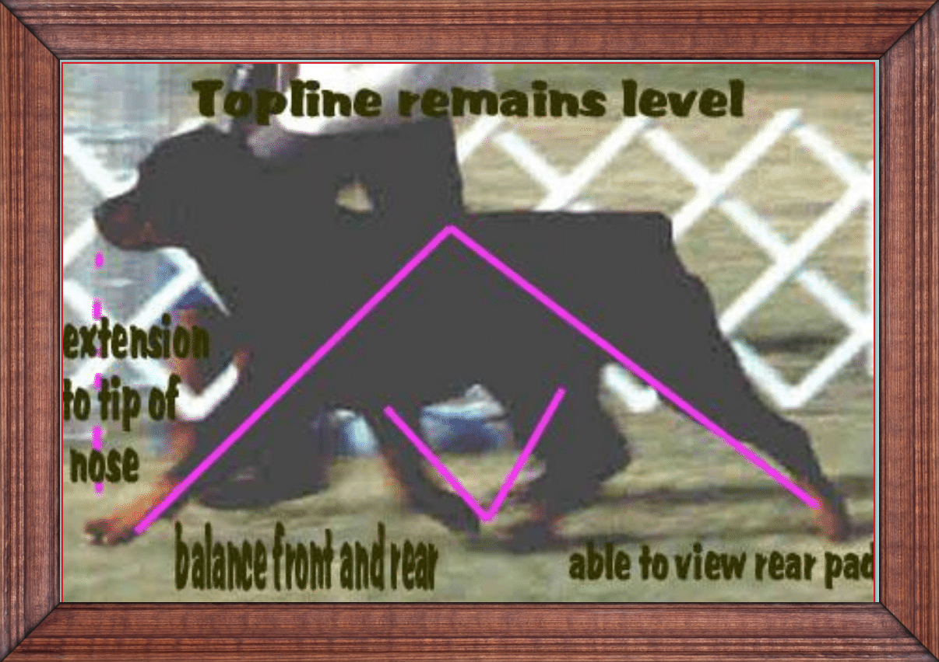
Front extension only to tip of nose
You should be able to see rear pad
Feet remain close to the ground

Slide 10
Center of Gravity
In the moving dog, the center of gravity changes always.
Raising and lowering the head, thrusting it forward or backward, changes the forces and weights involved.
The moving limbs, close to or far from the center of gravity, change its location.
Greater speed invariably requires larger movements of the center of gravity, lifting it repeatedly at the cost of greater energy expenditure in getting somewhere faster.

Slide 11
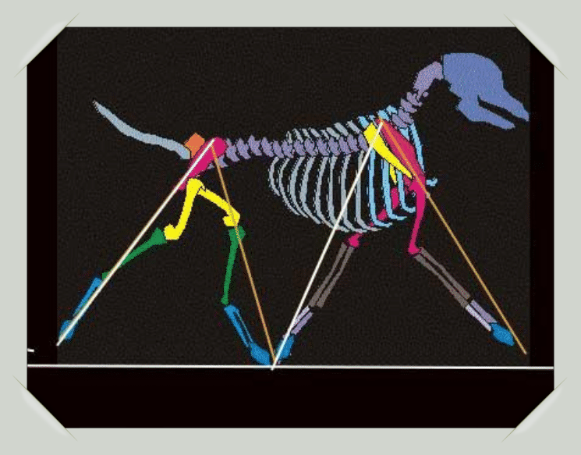

Slide 12
Coming and Going
The dog should be observed both “coming” and “going” (moving directly toward and away from an observer) as part of the observation gait.
Ideally, the limbs seen from the front and the rear should appear to the unaided eye to move in straight planes from the shoulder or hip joints, forward and backward, with the front and rear legs equal distant, so that the rear legs can scarcely be seen from the front, and vice versa.

Slide 13
Coming
As movement commences and for the first couple of steps, the feet travel straight forward almost the same distance apart at the feet and at the elbow.
Then as speed increases the feet gradually converge.
As speed in increased the straight column of bones from elbow to foot converges toward the center line under body and the legs are brought straight forward.

Slide 14
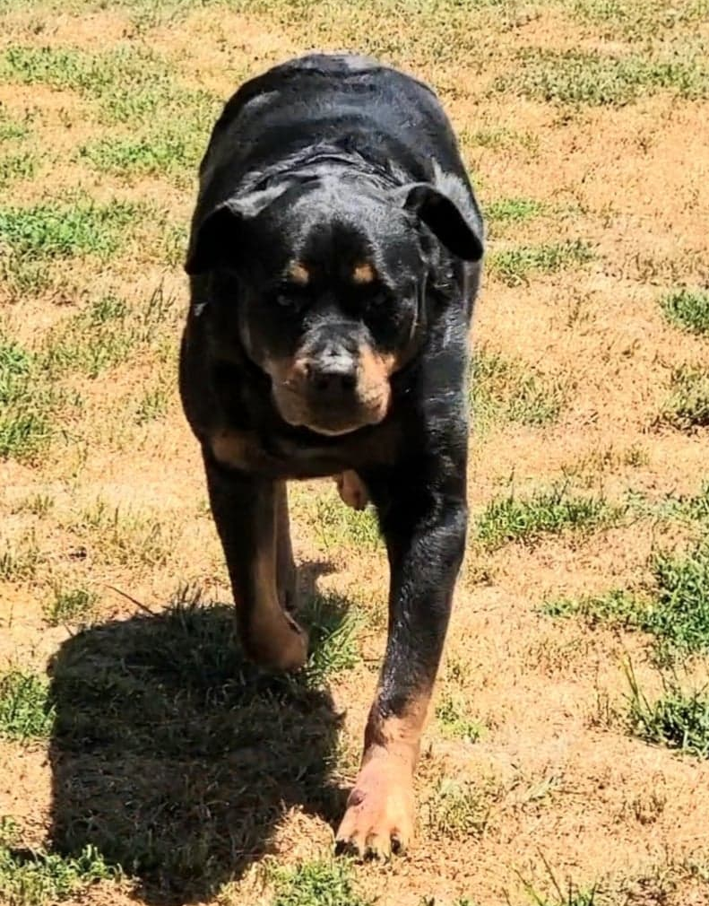
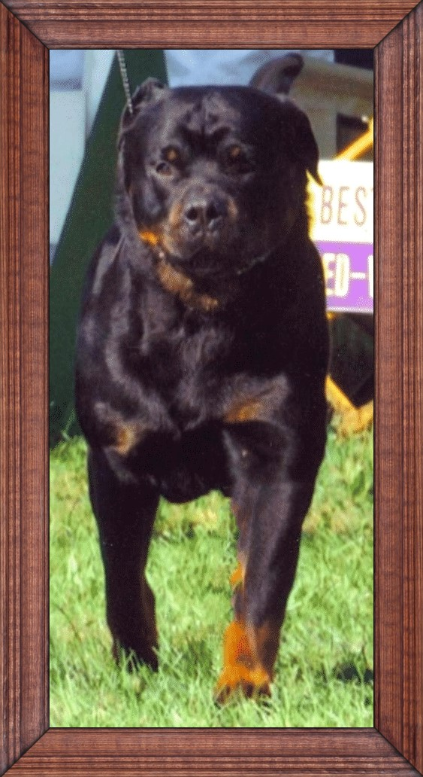
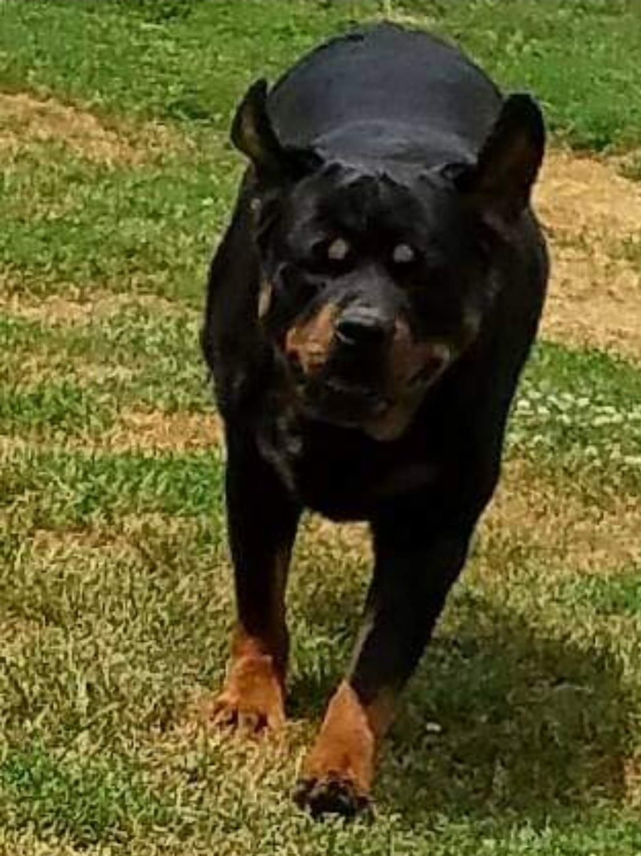
Coming
When the dog is coming or going you should
only see one set of legs.

Slide 15
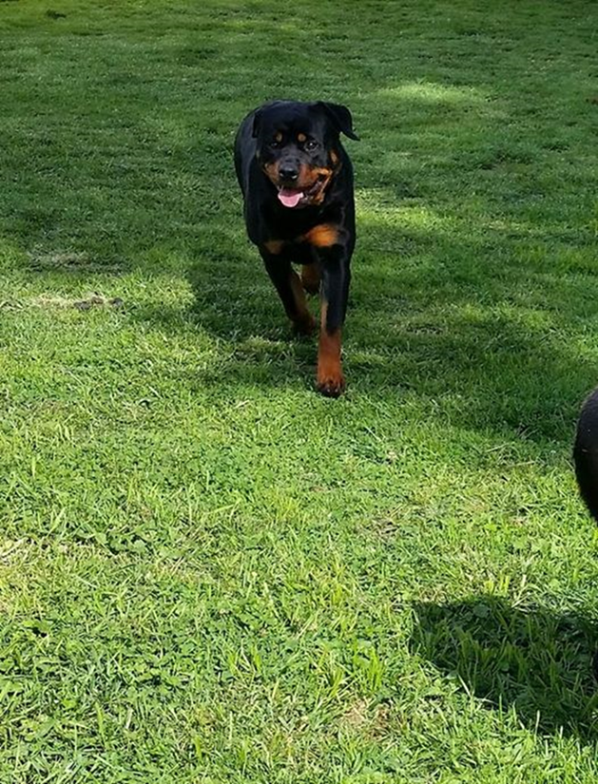
When moving towards the viewer at a trot, the legs converge in a straight column towards the central point of gravity.
Imagine a V formed from the shoulders to the foot pad.
Elbows should turn neither In nor out.
The pads should not flip to the side.

Slide 16
Rear Movement
When moving away at a trot, the rear feet and legs of the dog should converge towards, the centerline of gravity.
Imagine a straight line drawn from the hip joint to food pad.
As the dog increases speed, these lines form a V shape with the widest points at the hips and narrowing towards the pads of the feet.
Hocks should not swivel, bow outward (open hock) or turn inward (cow hocks).
When driving from the rear, you should see the pad of the rear foot.

Slide 17
Rear Movement
Able to see rear pads

Slide 18
Coming and Going: faulty movement
From the front we see:
From the rear we see:
Crabbing
Winging
Paddling
Toeing in
Weaving-legs
Out-at-the-elbows
Tied-at-the-elbows
Running-wide
Flipping
Crabbing
Cow-hocks
Moving close
Popping-hocks
Barrel-hocks
Running-wide
Weaving-legs

Slide 19
Movement Faults
“Crabbing”, or hind legs falling so one is between the front legs, and the other to either side of the front leg (sometimes alternately).
Indicates that rear “reach” is greater than front “reach” for some reason, or that the dog is too short in body.
“Elbowing out” occurring in a dog that stands correctly, or “winging”, padding”, “hocking in” or “out”, “toeing in” or “out”, “swinging” one leg more than another.
All indicate a lack of balance somewhere that requires compensation, not necessarily the offending limb.
Minor aberrations in joint structure as well as incorrect bone proportions may be implicated.

Slide 20
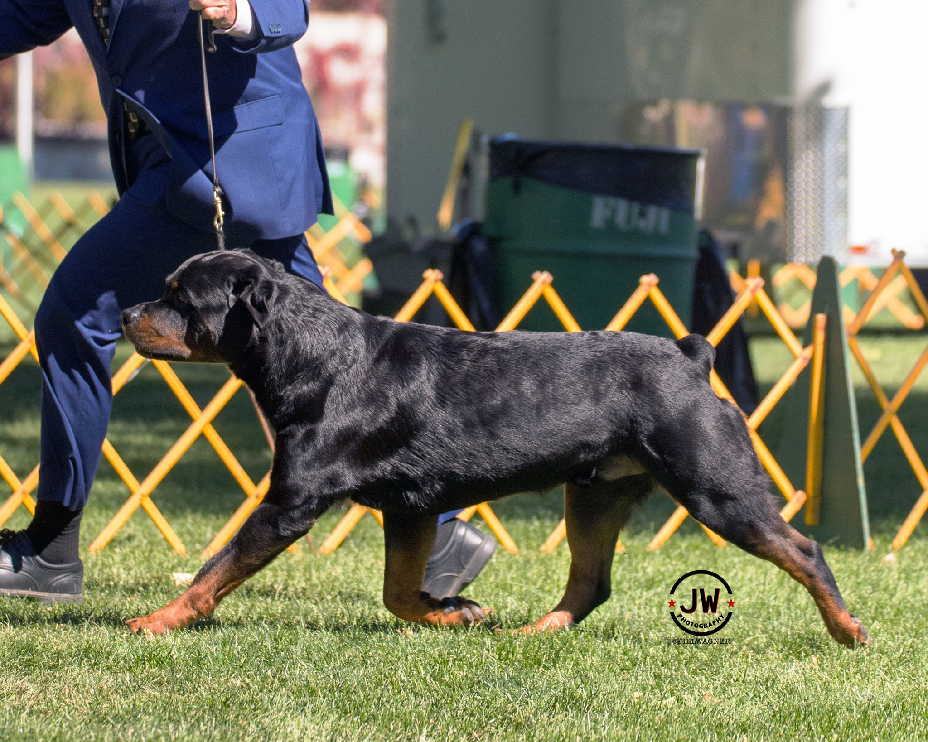
Reach and Drive
The front step is the same length as the rear step when the front and rear angulation are correct and in balance.
The forequarters should work in harmony with the rear.
One end should never be out moving the other.
The legs and feet should move in line with the body.

Slide 21
Reach and Drive
Front and rear must be in perfect balance with good reach in front and drive in rear.
The topline remains level from the shoulders to the rump.
When the Rottweiler moves correctly, all four legs reach forward and extend rearward at equal distances.
The front paw flexes (thus the need for a slight bend to the pastern) on the follow through under the body and the hind foot slips neatly under it to occupy the spot vacated by the front foot.

Slide 22
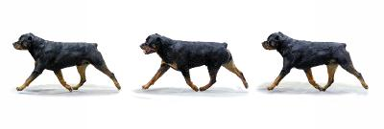
Reach and Drive
The topline should remain level while the dog is in motion without evidence of bouncing or rolling from side to side. The back should not sag, sway or be roached.

Slide 23
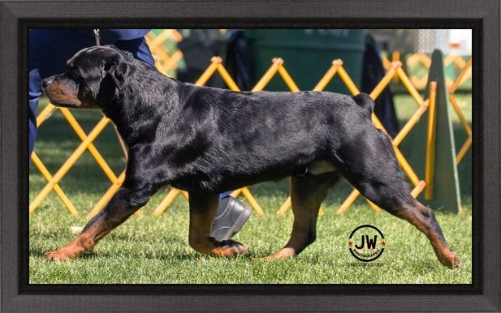
Hind legs show equal length of reach to the forelegs.

Slide 24
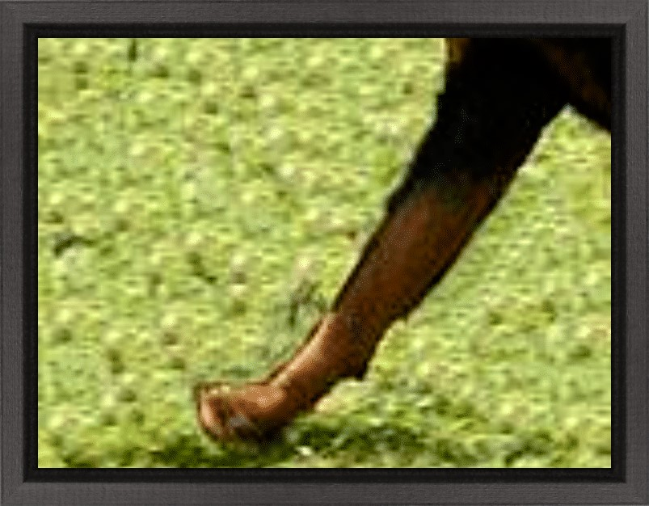
Poor Side gait
Flipping
Usually, a problem with the pastern

Slide 25
INCORRECT:

Slide 26
Overreaching
Overreaching at the trot is a common fault, caused by more angulation and drive from behind than in the front, so that the rear feet are forced to step to one side of the front feet to avoid interference or clipping.
Overreaching is a common fault in puppies as they develop through “leggy” stages when the height at withers may exceed length from buttocks to shoulder joint by a fractional difference. As the puppy develops and body proportions come into balance, the overreaching ceases.

Slide 27
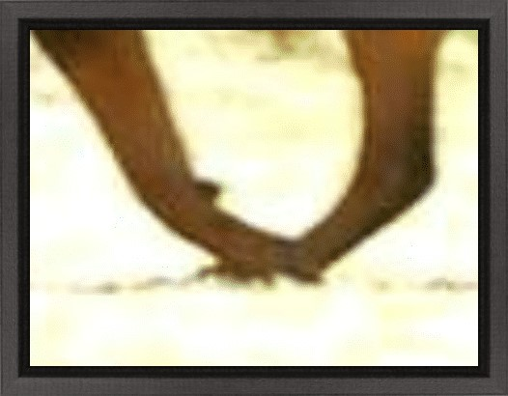
Perhaps the most common fault of movement is over-reaching, which occurs when the rear legs extend so far forward as to pass the front legs. As this happens, the dog is forced to compensate. The most common form of compensation occurs when the dog swings it legs to one side on a bias to the line of travel.
Perhaps the most common fault of movement is over-reaching, which occurs when the rear legs extend so far forward as to pass the front legs. As this happens, the dog is forced to compensate. The most common form of compensation occurs when the dog swings it legs to one side on a bias to the line of travel.
overreaching

Slide 28
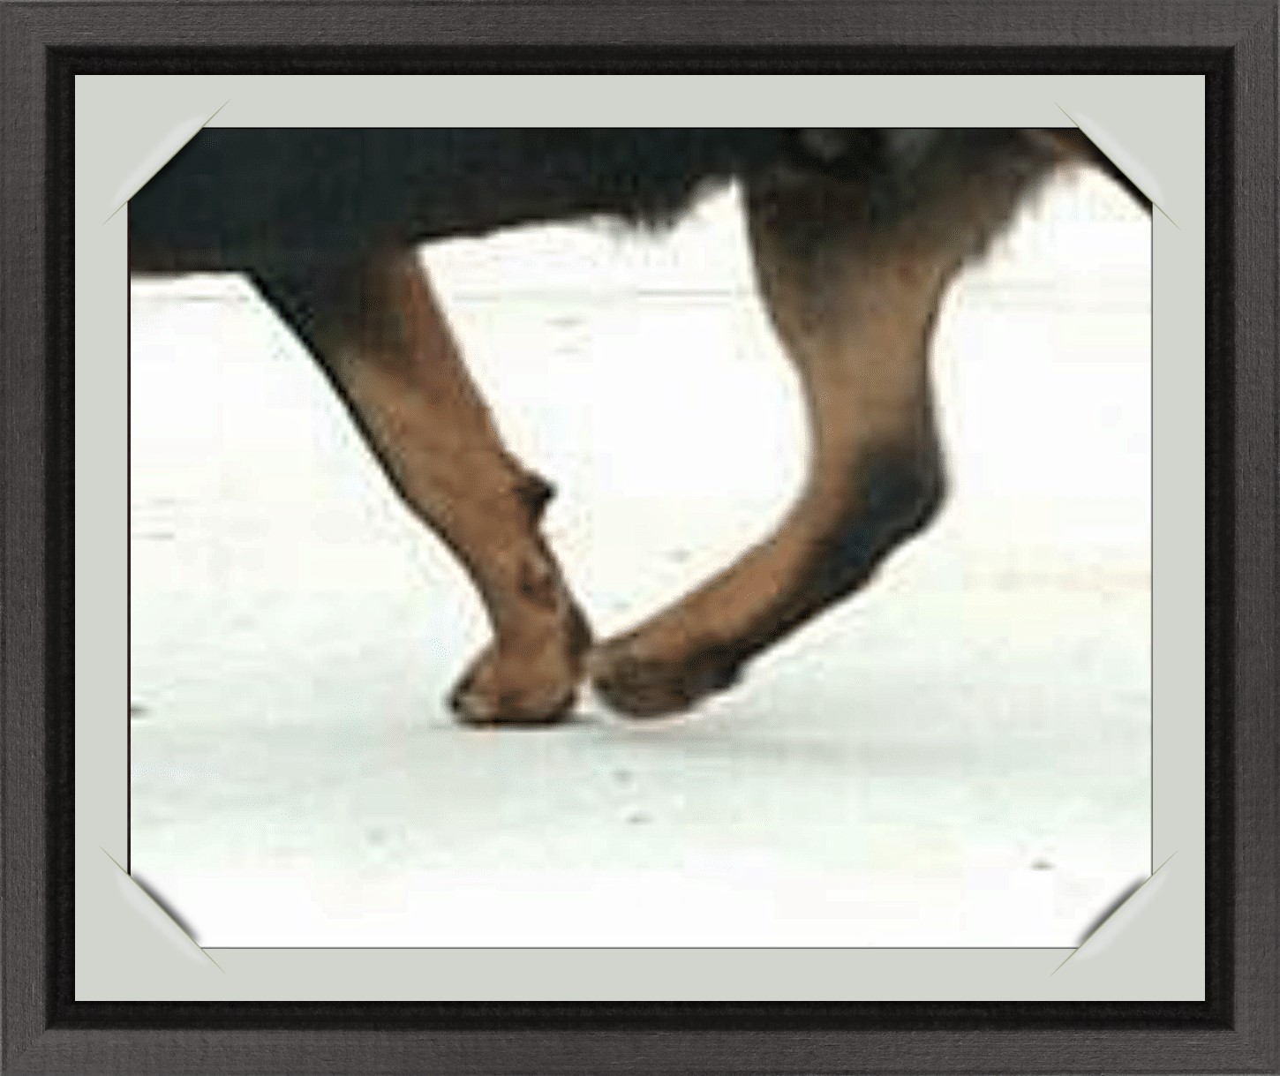
Correct
As the pastern flexes at the most backward and upward point underneath the body, it must be times to lift out of the way of the hind foot landing beneath it, ahead of it—because of the forward momentum of the dog.

Slide 29
Side Gait
The side gait is more revealing to the educated observer.
Ideally the position of the head is moved slightly forward and lower as the dog speeds up.
A very upright head carriage will indicate stiffness or lack of angulation, usually in the shoulders, and perhaps cause restriction in the forward reach (which is as far as the nose), or a hackney- type gait.
The neck should retain a slight arch at any gait, blending smoothly into the topline.

Slide 30
Dips behind the shoulders, or excessive rolls may indicate poor structure or lack of fitness.
A topline that appears to “V”, jouncing and breaking in mid-back at every stride, displays a severe lack of balance.
The forelegs should move with a pendulum-like action, equally forward and backward, with maximum “reach” but minimal lift from the ground.
At its greatest forward extension, easy to observe because of the momentary halt in action as the leg reverses direction, the leg and foot should form a straight line.

Slide 31
Improper shoulder set or short overly muscled necks would prevent the dog from carrying the head high with confidence and would instead give the look of trundling. Without proper angulations, hip and shoulder set improperly overreaching or shortened reach and/or drive are exhibited.

Slide 32
The hind legs should show an equal length of reach to the forelegs, extending well under the body, and equally well back.
The feet should not kick up high under the belly, and the whole leg should straighten well through the joints as it extends back, with no wasted motion.
The feet should always remain relatively close to the ground, even at full extension.
The legs should form an apparently straight line at the furthermost point of extension.

Slide 33
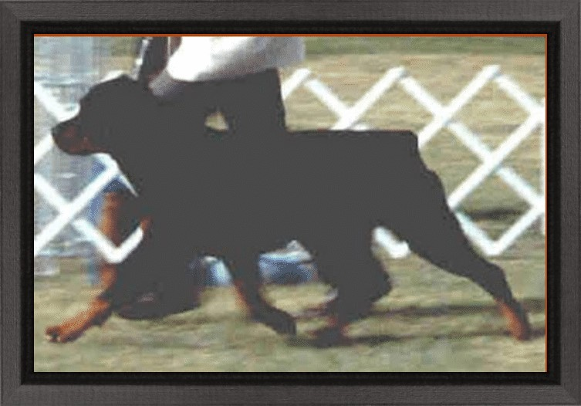
From the side view the hock joint should both flex and extend.
All action is aimed at the dog placing each foot as closely as possible beneath the center of gravity while it is supporting the dog’s weight.
Notice the top line remains level and the head is carried at a 45-degree angle while moving, indicating well laid-back shoulders.
From the side view the hock joint should both flex and extend.
All action is aimed at the dog placing each foot as closely as possible beneath the center of gravity while it is supporting the dog’s weight.

Slide 34
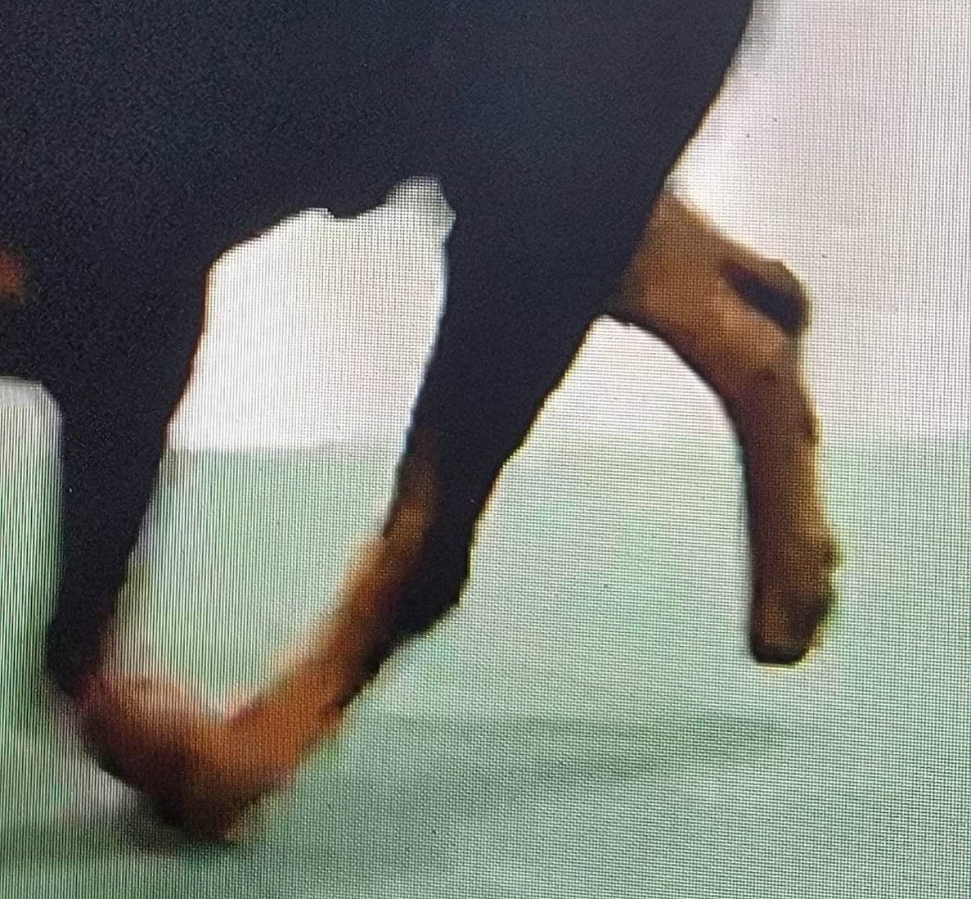
Incorrect
Correct
The hock joint should both flex and extend.
Sickle hocks are easily seen on the backward swing of the rear leg during movement. Instead of the joint between the lower thigh and the hock opening into a nearly straight extended line, where the pads on the bottom of the foot end in a position that is nearly straight up (or reaching toward the sky), the sickle hock, due to the imbalanced length of the bones, at fullest rearward extension ends in a shape resembling a sickle – slightly curved instead of fully extended.

Slide 35
There is a very slight forward motion of the entire dog’s body when both front and rear feet are off the ground simultaneously. In a very slow trot there is always one foot on the ground, a part of the time two feet, and a part of the time three. If fast, there are two intervals in each stride when all feet are off the ground.

Slide 36
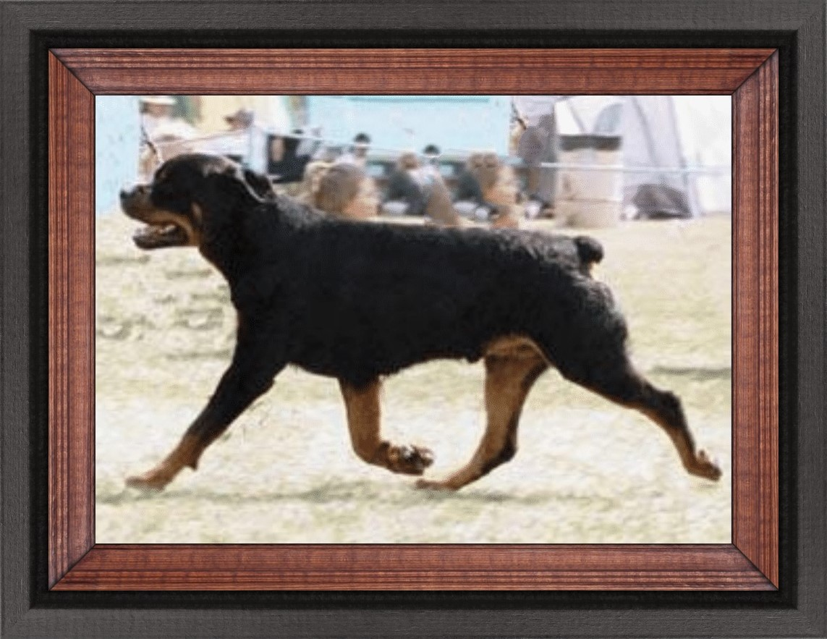
Extending well under body

Slide 37
Conditioning and muscle tone
Ever wonder why a dog looks like he is built to move, but doesn’t seem to get the job done?
It is usually do to lack of conditioning which affects muscle tone and ligaments, both of which are important to the well moving dog.
Crated dogs rarely have good muscle tone.
Often dogs move bad due to lack of training on the leash, and different surfaces, such as grass, gravel, etc.
Train your Rottweiler on all surfaces.
Put the balance of breeding together with a well-trained dog.
C
EPS
2022

