Slide 1
Welcome to the Rottweiler Education Seminar
“A Study Guide for Rottweiler Structure”
EPS
2022

Slide 2
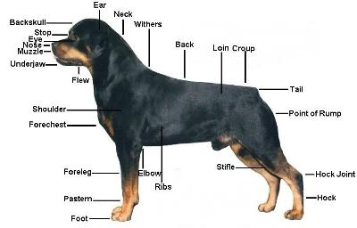
Rear Pastern

Slide 3
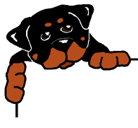
It All Starts With Responsible Breeding
As breeders, it is our responsibility to strive for total soundness. Remember, we are breeding for the quality of each dog's life as much as for the integrity of all future Rottweilers.
Championships and show points are meaningless if we breed structural faults into our dogs.
Working and performance dogs require the soundest possible structure, and we must adhere to the standard as to the structure of our breed.
Notes:
Breeders should not be capitalized (such as, you wouldn't say Plumbers), but I understand if you want it to stand out and be special
Note: this is a bit small and would be better if enlarged for presentation

Slide 4
Fault Judge Your Own Dogs
You must be severe!
A great show dog with a fault or two can still be the best dog on show day despite their imperfections. But in your own breeding program, if these faults are ignored, they will crop up time and time again, solidifying it in your pedigree.
A severe fault must be penalized either in the ring or at home. No matter how good the dog may be otherwise, when used as a stud the resulting puppies will nearly always be slightly less in quality than the stud dog.
Most faults can be bred out easily, such as darker markings or getting smaller ears, but severe faults will set you back for years. At home you must always fault-judge your own breeding dogs, recognize the deficiency and work to breed it out.

Slide 5
A good breeder understands form and function. The dog's work informs its structure and mental capacity. It is vital to understand the structure of the Rottweiler and why it's important for the work our breed does.
Know how the parts of the dog work together to create good movement as described in the Rottweiler standard.
Dogs will move how they are built. Structural faults will show up in the dog’s movement. Learn to see it while the dog is in motion.
Understand the functions or purposes that the Rottweiler breed was originally meant to perform.
Notes:
Again, the font was small for a projection screen if trying to read from the back of a room

Slide 6
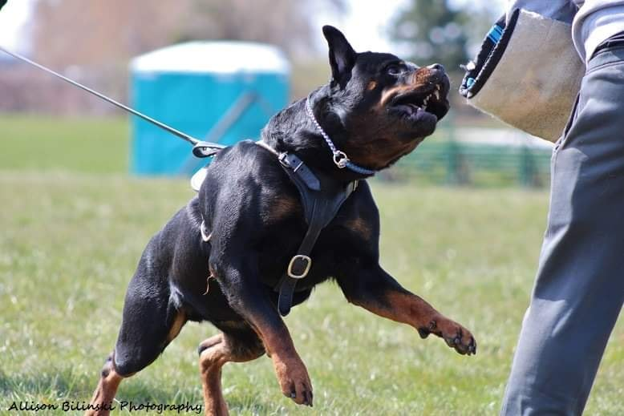
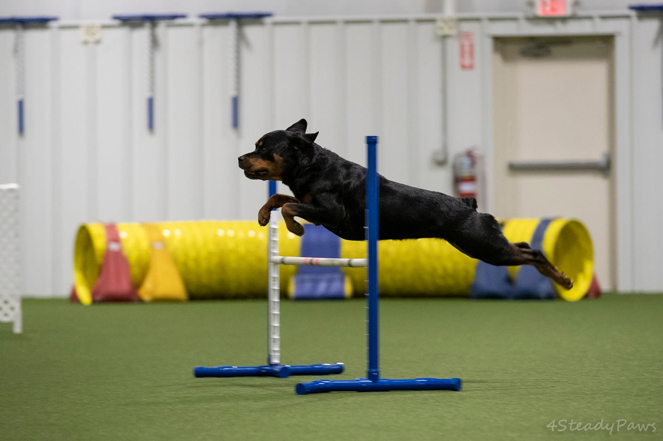
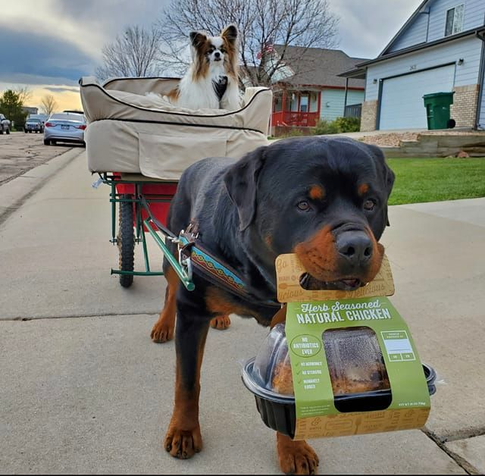
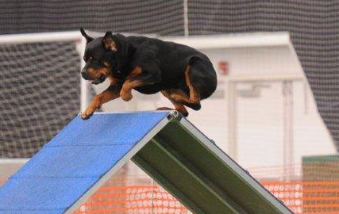
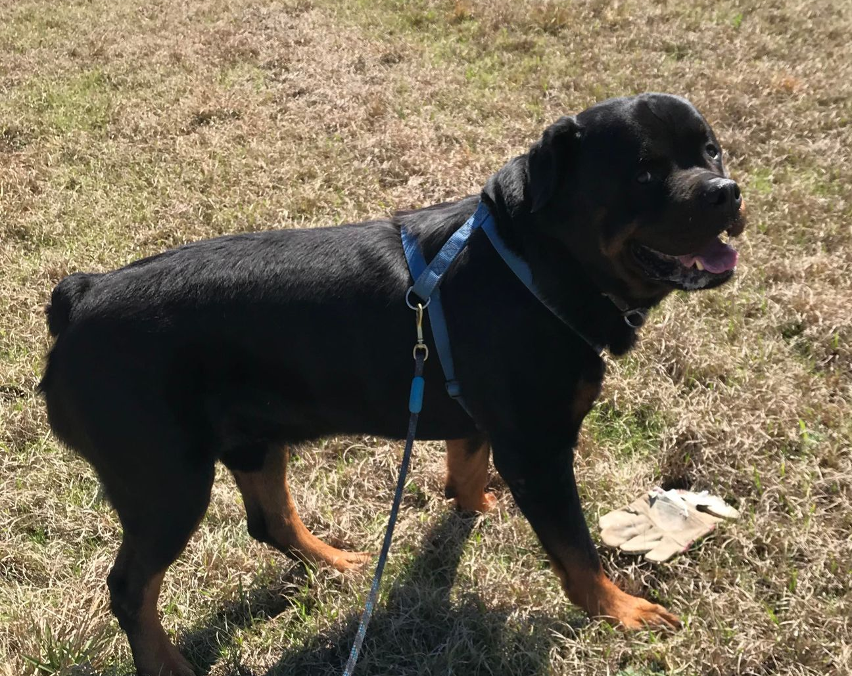
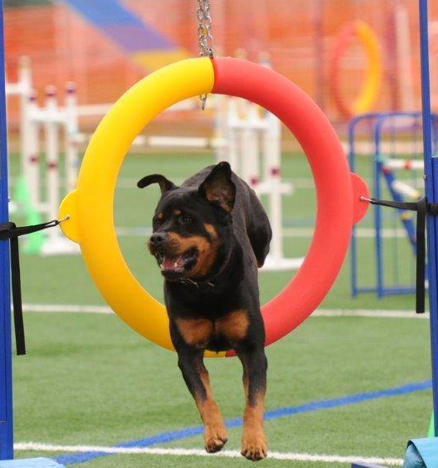
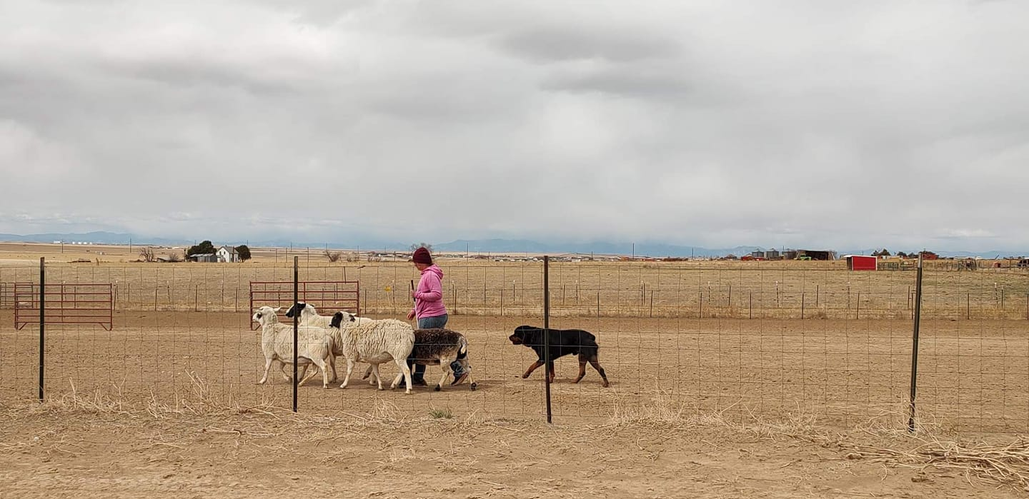
W
O
R
K
I
N
G

Slide 7
The Rottweiler
The American Rottweiler Club standard describes the Rottweiler as "robust and powerful. The Rottweiler is happiest when given a job to perform. His intelligence, endurance and willingness to work make him suitable as a police dog, herding, service dog, therapy dog, obedience competitor and devoted companion."
The Rottweiler is a medium-large, robust and powerful dog.
According to generally accepted principles, as an inherent protector, the Rottweiler is self-confident and responds quietly and with a wait-and-see attitude to stimuli in his environment.
A Rottweiler fits the above image while remaining an athletic and an all-purpose and loyal companion.
Notes:
Again, I enlarged the type

Slide 8
Rottweiler Proportions
Dogs 24 inches to 27 inches. Bitches 22 inches to 25 inches, with preferred size being mid-range of each sex.
The length of body, from prosternum to the rearmost projection of the rump, is slightly longer than the height of the dog at the withers, the most desirable proportion of the height to length being 9 to 10. The Rottweiler is neither coarse nor shelly. His bone and muscle mass must be sufficient to balance his frame, giving a compact and very powerful appearance.
The 9 to 10 length of the body from the point of shoulder to the rear point of the croup is slightly longer than the height of the body from the ground to the top of the withers.
The desirable slightly longer proportion is not derived from a long back, but from overall length which in relation to height is achieved by length of forequarter, length of withers and hindquarters viewed from the side.
Notes:
I suggest breaking this into 2 slides and increasing font size. Could also do it as bullet points rather than sentences.

Slide 9
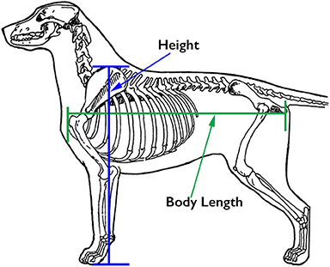
Rottweiler Proportions
9 to 10
The minimal increase in length allows more freedom of movement because of less interference between the front and rear feet as the dog moves.
The Rottweiler is neither a tall nor short legged dog. A short-legged, heavy boned dog is not desired. The chest should reach the elbows, and the chest depth and leg length proportion should be about 50/50.

Slide 10
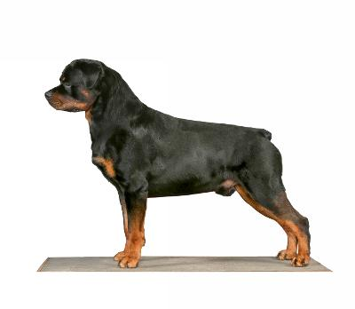
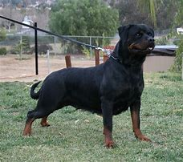
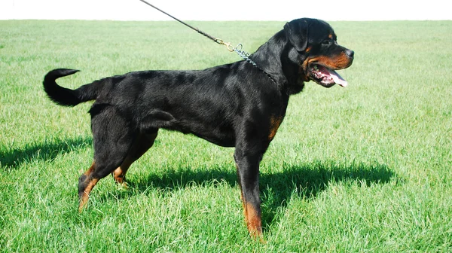
Correct
Short on leg
long

Slide 11
The Rottweiler Head
Erect head carriage, held slightly ahead of the body when standing.
The head is of normal proportions relative to the size of the dog and of normal shape, neither long and narrow nor short and wide overall.
A Rottweiler should have a strong, powerful head with broad jaws.
The skull is slightly longer than the muzzle, almost flat on top.
The nose and lips must be black.
The Rottweiler nose is well developed, broader than round, with relatively large nostrils and always black.
The muzzle should appear neither elongated nor shortened in relation to the cranial region. The nasal bridge is broad at the base and moderately tapered.

Slide 12
The Rottweiler Head
Of medium length, broad between the ears
Forehead line seen in profile is moderately arched;
Zygomatic arch and well developed stop
Strong, broad upper and lower jaws
The desired ratio of back skull to muzzle is 3 to 2.
Forehead is preferred dry; however, some wrinkling may occur when the dog is alert.
Expression is noble, alert and self–assured.

Slide 13
The Rottweiler is Not a “Head Breed”!​
The importance of the Rottweiler head is to identify the Rottweiler as a Rottweiler. Keep head conformation in proper perspective: the head is important and essential to breed type, but we are more than a pretty face.
A head breed is a breed that has let the head become the most defining part of breed type. When a breed concentrates on heads to the exclusion of other qualities, those other qualities suffer. What results is a breed with a beautiful head, which his body usually has poor structure, proportions, and movement. Observe other breeds; it will become obvious which ones are “head breeds”.
It is easier to correct head type in a breeding
program than it is to correct structural faults.
Notes:
Dang it I lost the text here!!

Slide 14
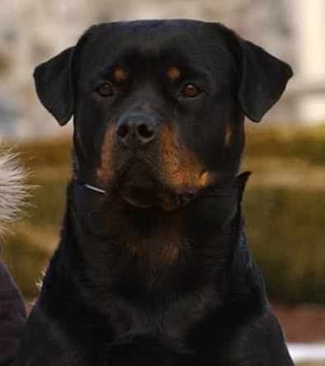
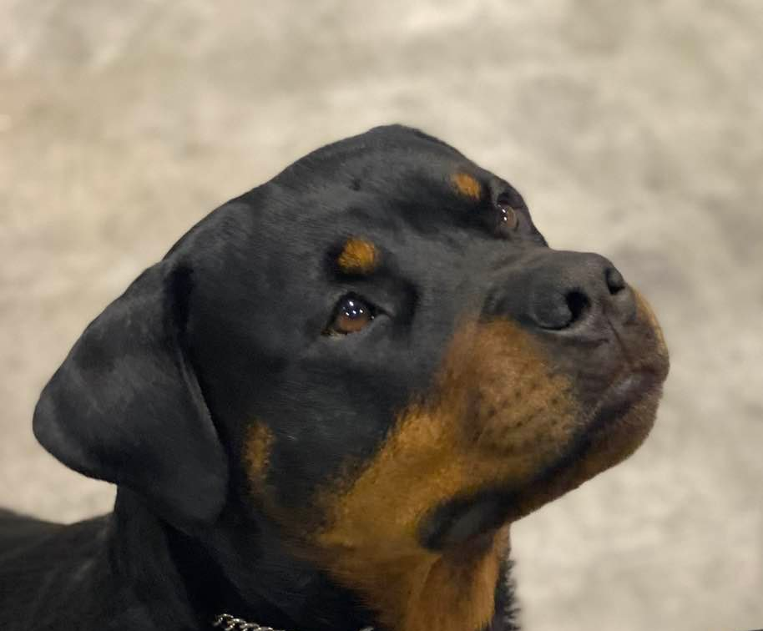
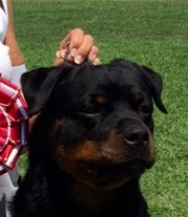
Bitch Heads
Notes:
ENLARGE THESE PHOTOS

Slide 15
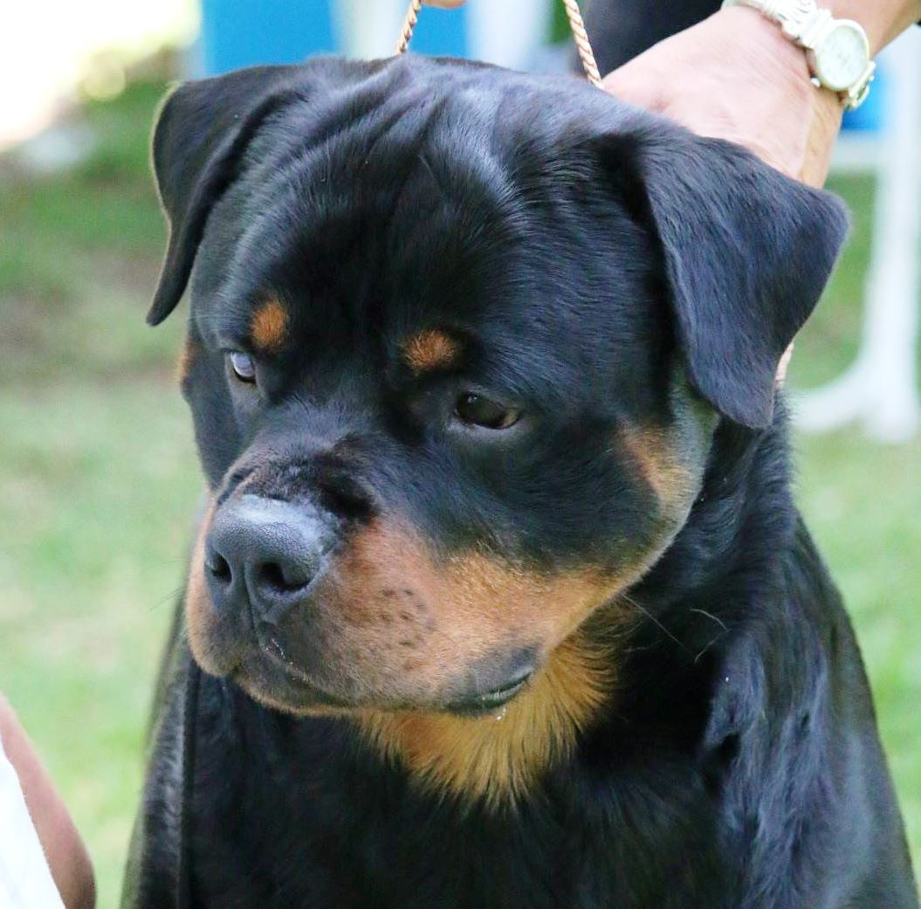
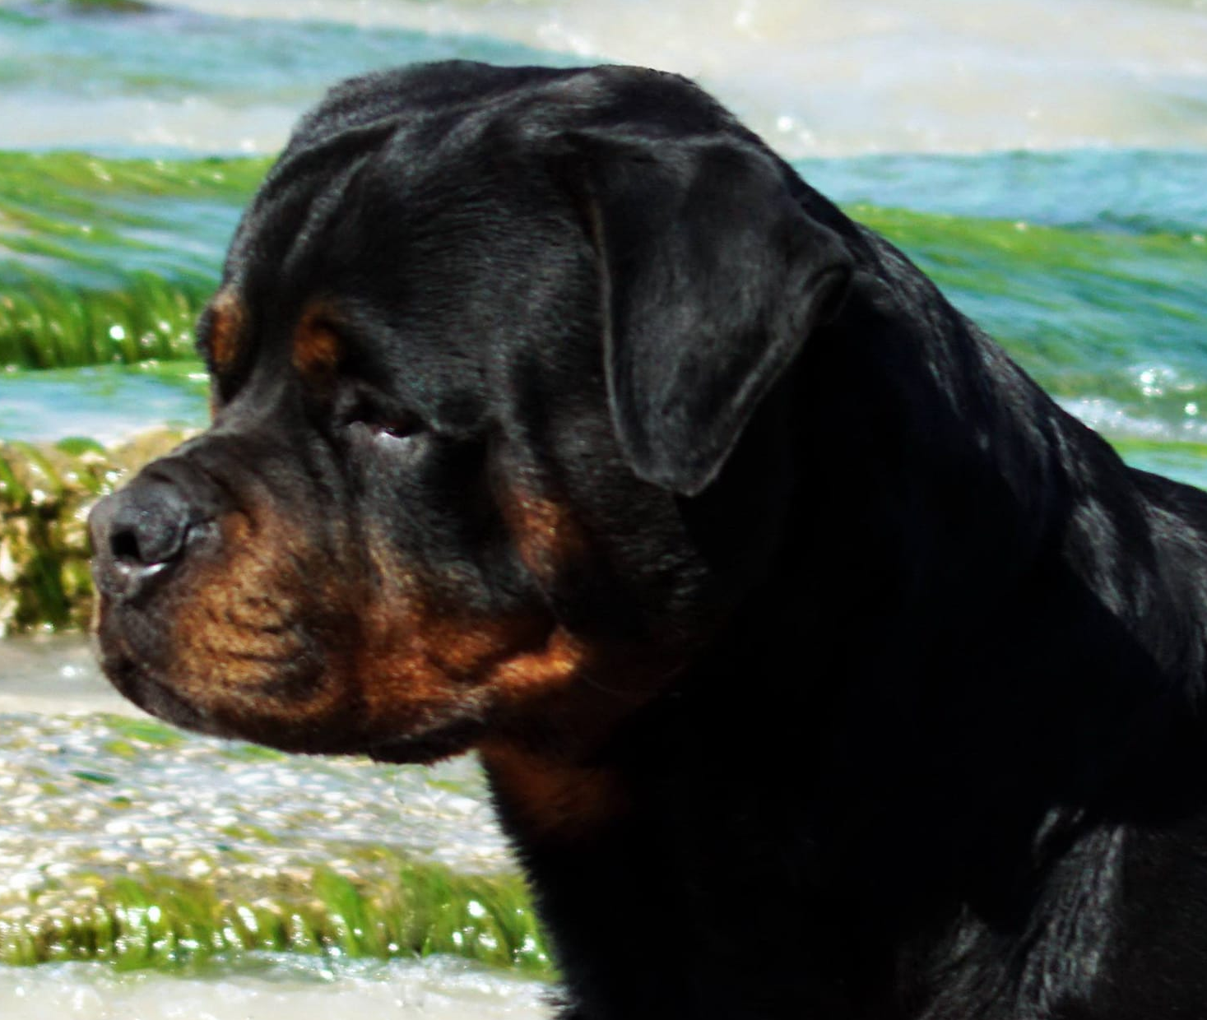
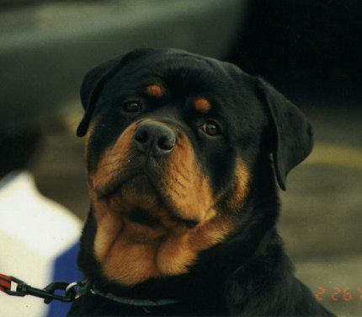
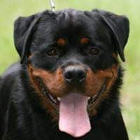
Dog Heads

Slide 16
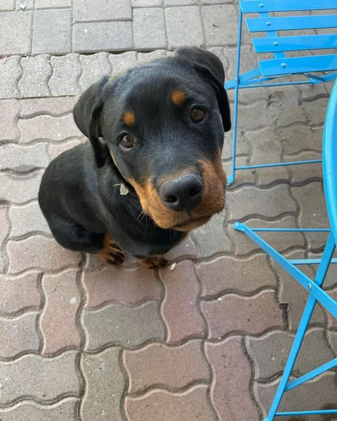
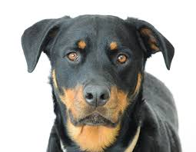
Head Type: Incorrect
Overdone
Lacks fill
Snipy, poor ear set, light eye

Slide 17
Eyes
The eyes are almond shaped, dark, set
facing normally forward
Eyes should be in proportion to the head, not too large, but not too small. The shape of an almond is pointed at each end and rising in the middle. The Rottweiler eye is NOT ROUND!

Slide 18
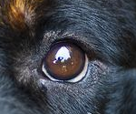
Medium Brown
Dark brown, almond shaped
Correct
Round Eye (Undesirable)

Slide 19
Hairless Eye Rim
Yellow (Bird of Prey) eye
Different color eye
Faults

Slide 20
Ears
The ears are medium-sized pendant, triangular, wide apart, and not set high on the head.
Ears are triangular, hanging down, close to the cheek; not too small as to be light and flyaway but not too large; they are set in line with the top of the skull, giving the appearance of broadening the skull; they should hang flat with no creases, not stand away from the head and there should be no daylight between the inner edge of the ear and the face. Neither should they be low set which gives an impression of houndiness.

Slide 21
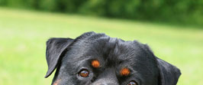
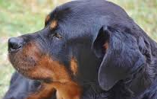
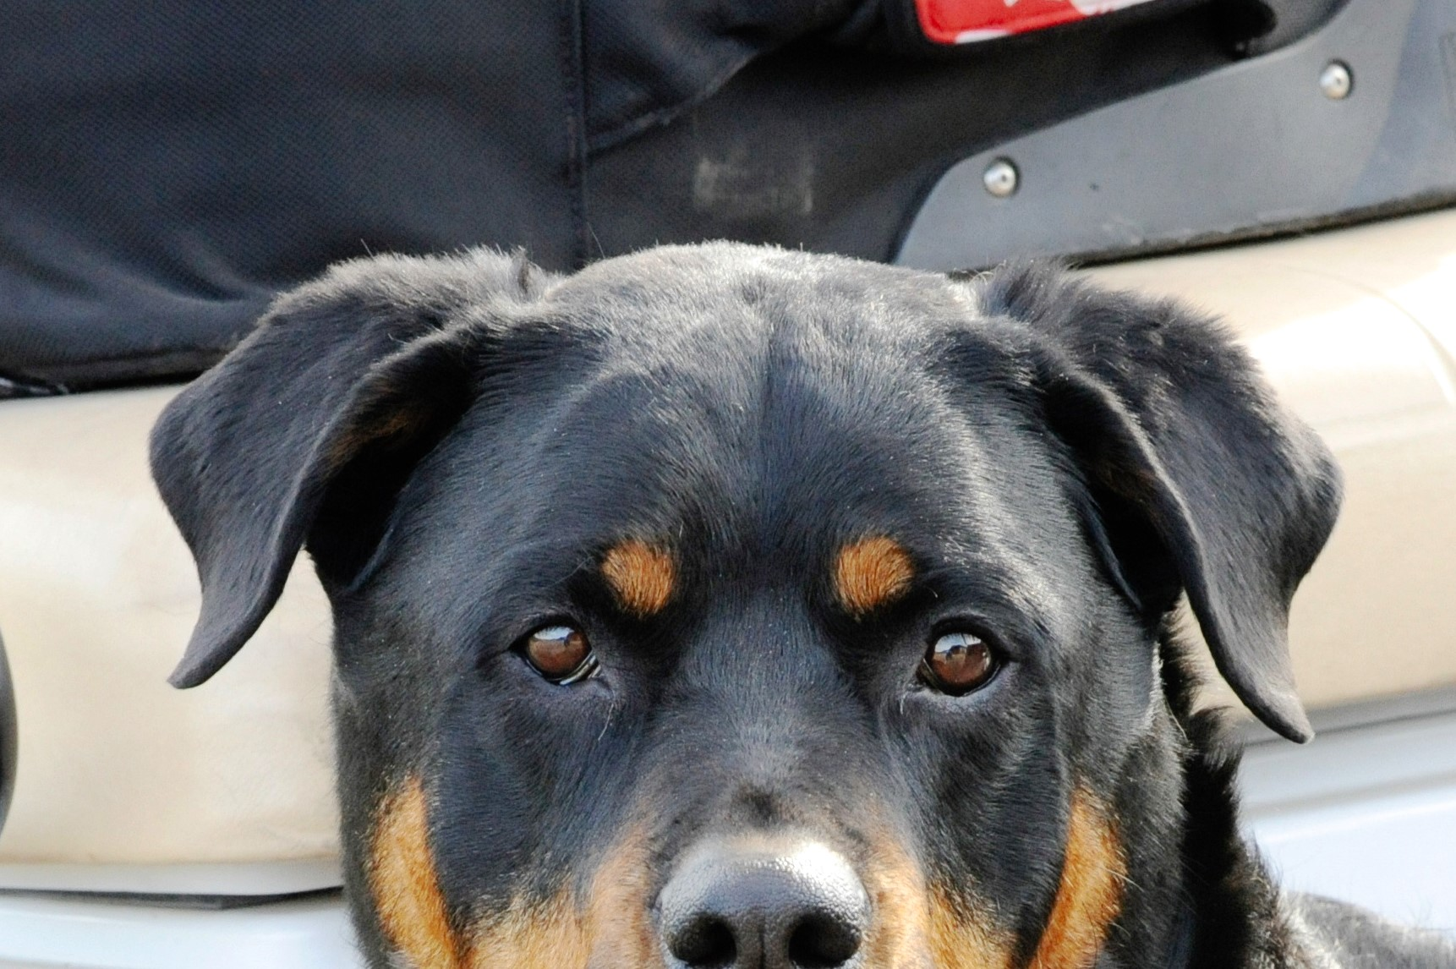
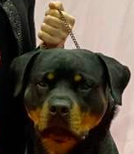
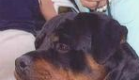
Ears
Low Ear Set
High Ear Set
Correct Ear Set

Slide 22
Teeth
Rottweilers should have strong and complete dentition (42 teeth) with a scissor bite. The upper incisors closely overlap the lower incisors.
Serious Fault: level bite; any missing tooth.
Disqualifications: Overshot, undershot, wry mouth; two or more missing teeth.

Slide 23
The normal bite of dogs with muzzles of medium length and width is a scissors bite.
The dog's bite is determined by the shape
of its head.
Occlusion is controlled by genetics, nutrition, the environment and mechanical forces generated by the interlock of upper and lower teeth.
Malocclusions and missing teeth have been proven to be genetic.

Slide 24
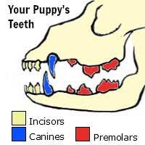
Teeth
Adult: 42 teeth
The puppy dentition contains a total of 28 baby teeth

Slide 25
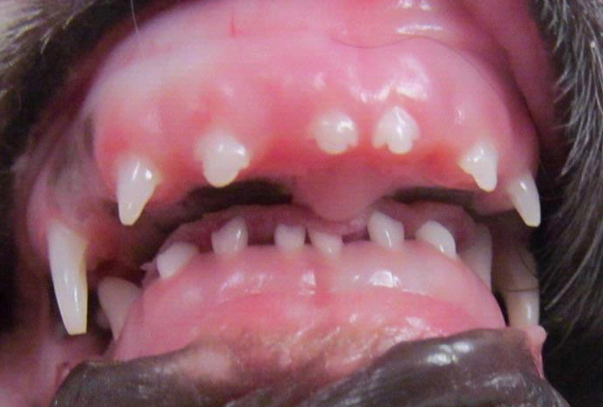
Examples of Abnormal Bites
Overshot
Wry
Undershot
Malocclusion
Puppy/Overshot

Slide 26
Mouth Pigment
The inner mouth pigment is preferred dark.
Serious Faults - Total lack of mouth pigment (pink mouth).
Flews are the upper and lower lips meeting in the corners of the mouth. They should be tight without openness, complimenting the overall dryness of the head. Ideally, mouth pigment is dark with little or no pink pigment visible.

Slide 27
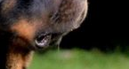
Undesired: Loose Flews
Notes:
Enlarge!

Slide 28
Dark gums
Preferred
Pink gums
Serious Fault
Correct/Dark
Pink gums

Slide 29
Underjaw
The power of the jaws and strength of grip come from the lower jaw since that is the jaw that moves.
Many breeds are losing their underjaw since breeders are not selecting for it.
Teeth are getting smaller. If we breed for the correct length of underjaw, we will retain correct sized teeth.
Notes:
LOVE THIS

Slide 30
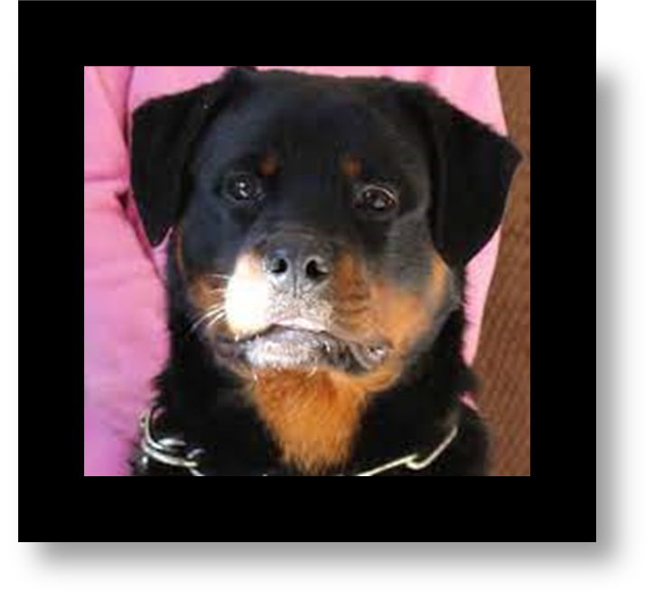
Correct Underjaw

Slide 31
Coat
Outer coat is straight, coarse, dense, of medium length and lies flat. Undercoat is present on neck and thighs and can be influenced by climate. Undercoat should not show through outer coat.
The coat is shortest on head, ears and legs, longest on breeching.
The Rottweiler is to be exhibited in the natural condition with no trimming.
Fault: Wavy coat.
Serious fault: open coat, excessively short, or curly coat; total lack of undercoat; any trimming that alters the length of the natural coat. Disqualification-Long coat

Slide 32
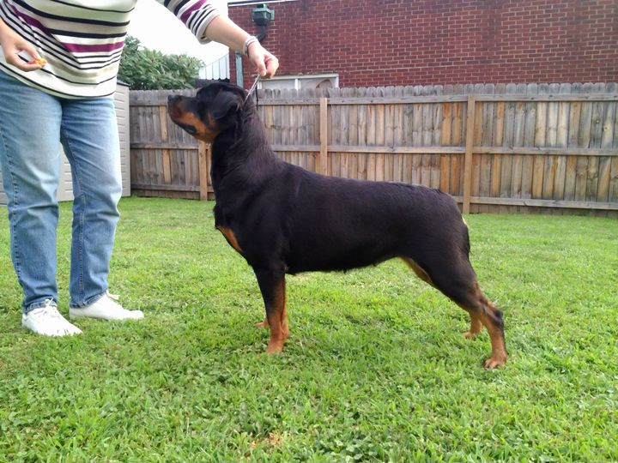
Correct Coat
Insert pictures

Slide 33
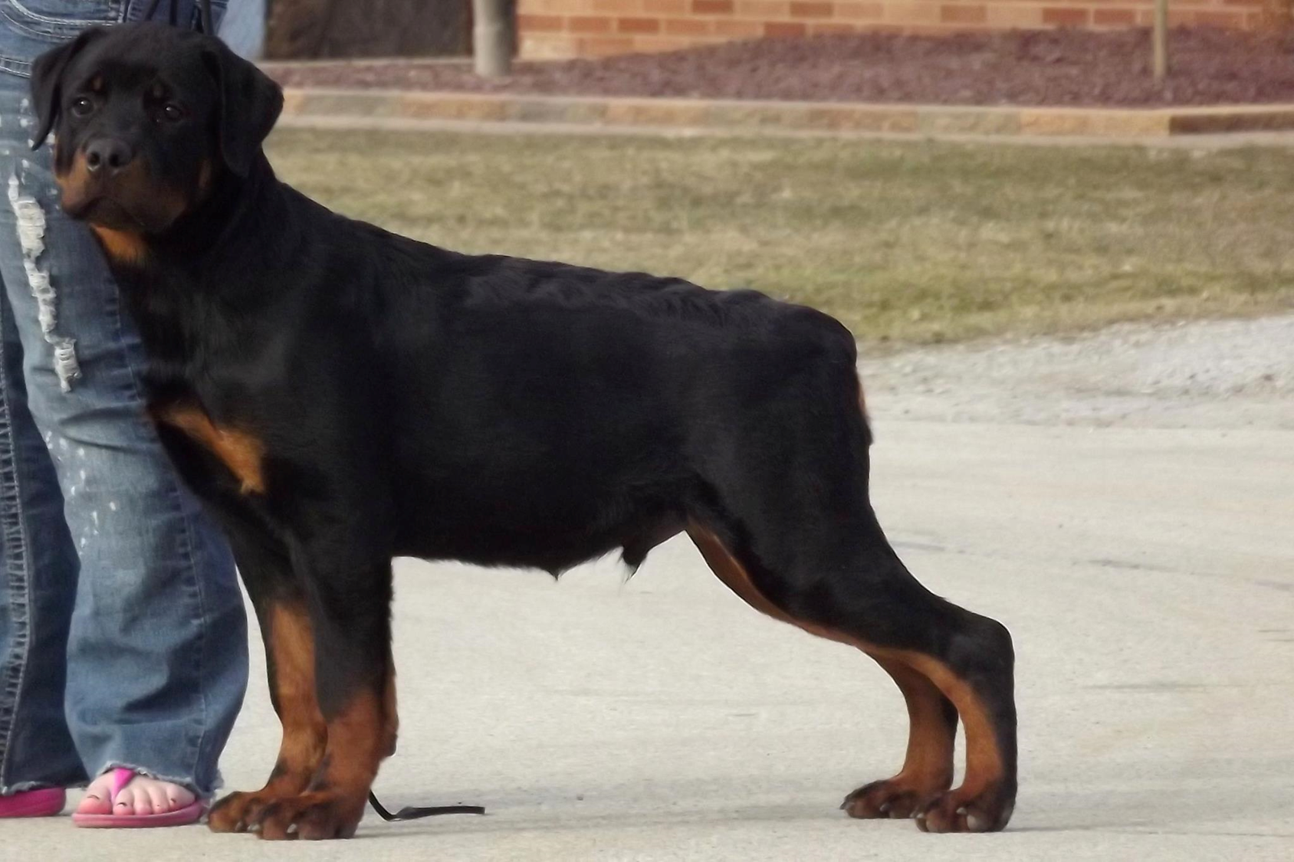
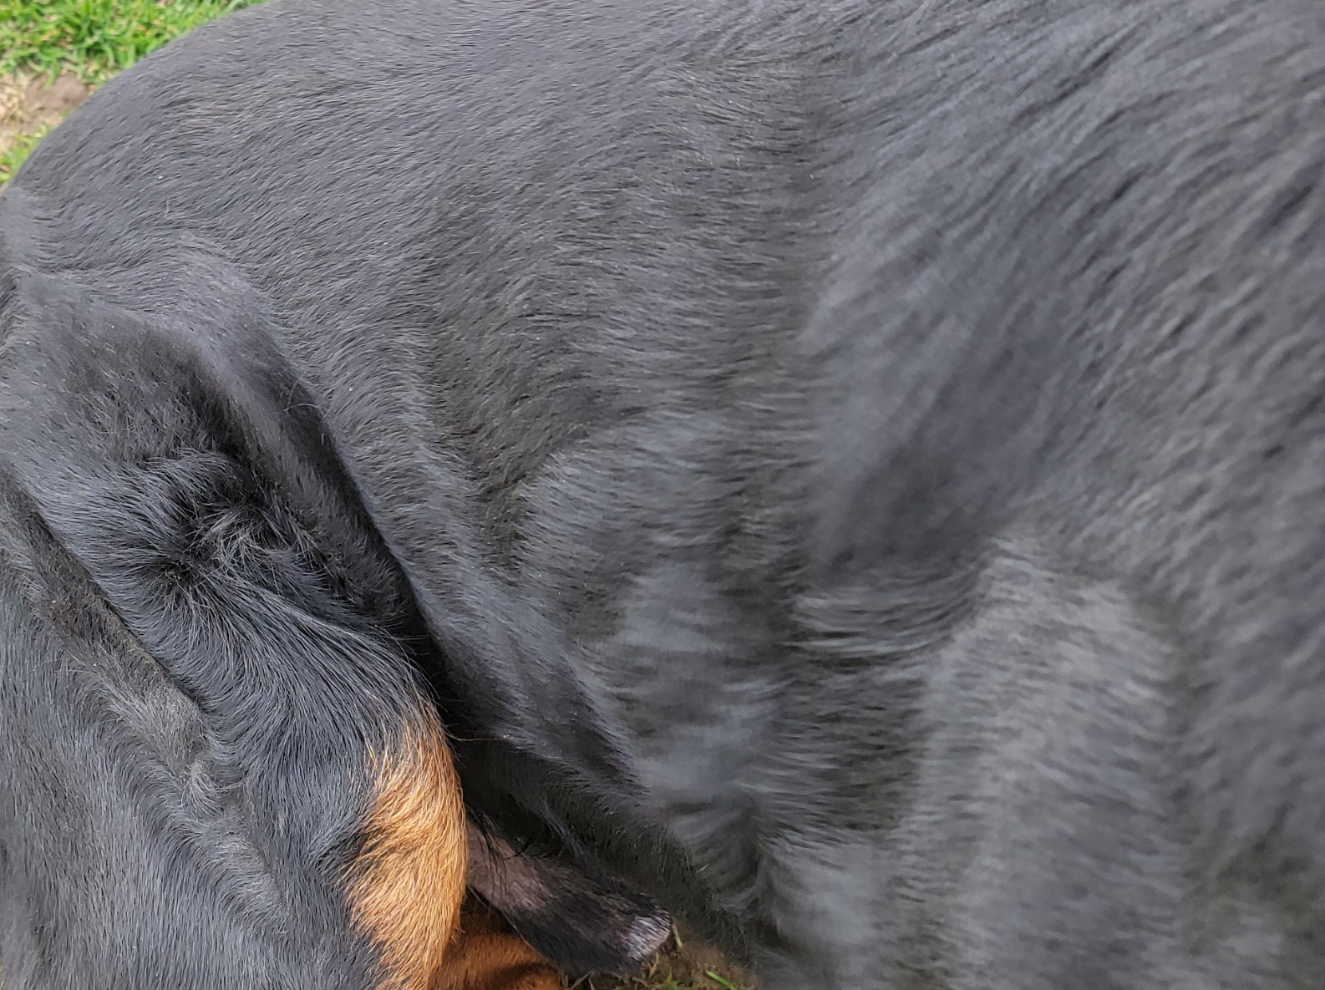
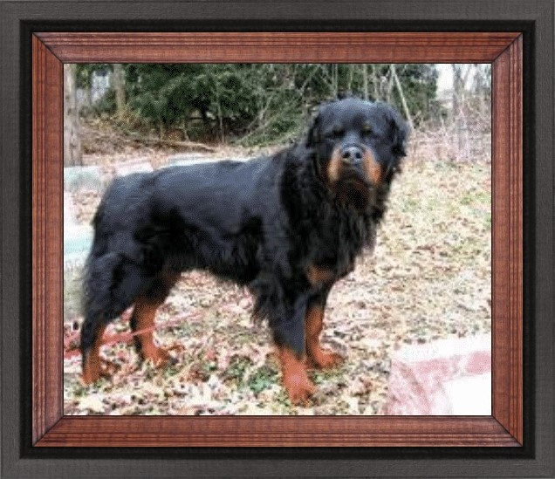
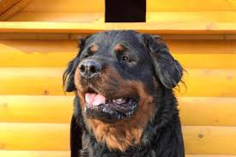
Wavy coat on puppy, will usually go away
Serious fault:
Open coat
Disqualification:
Long coat
Serious fault: Any trimming that alters the length of the natural coat

Slide 34
Color
Always a black base with rust to mahogany markings.
Clearly defined demarcation between black and rust. The markings should be located as follows: a spot over each eye; on cheeks; as a strip around each side of muzzle, but not on the bridge of the nose; on throat; triangular mark on both sides of prosternum; on forelegs from carpus downward to the toes; on inside of rear legs showing down the front of the stifle and broadening out to front of rear legs from hock to toes, but not eliminating black from rear of pasterns; under tail; black penciling on toes. The undercoat is gray, tan, or black. Quantity and location of rust markings is important and should not exceed ten percent of body color.
Serious Faults-Straw-colored, excessive, insufficient or sooty markings; rust marking other than described above; white marking any place on dog (a few rust or white hairs do not constitute a marking).

Slide 35
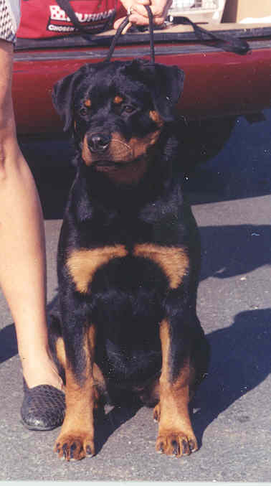
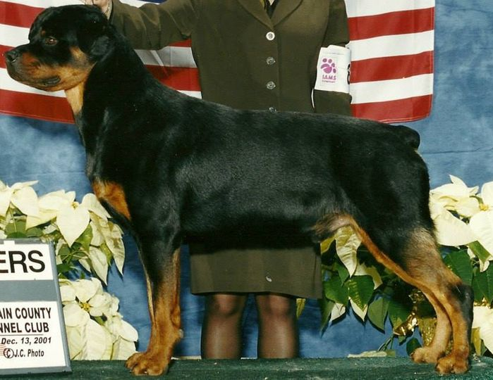
Correct color

Slide 36
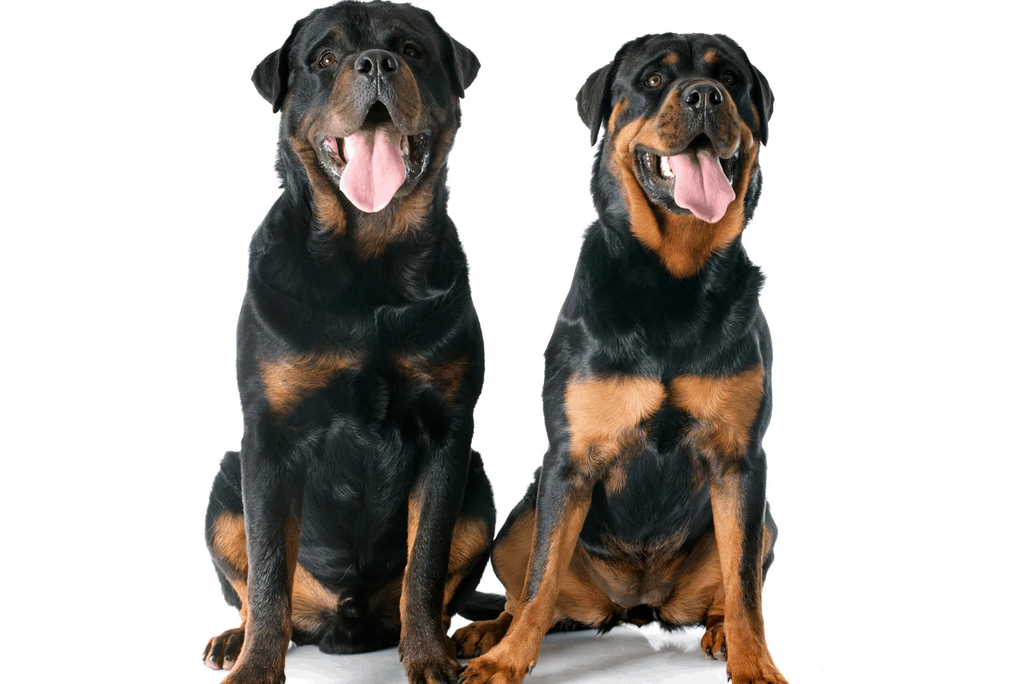
Serious Faults:
Insufficient or sooty markings
White Markings
Excessive markings
Notes:
If possible, I would make photos of dogs larger

Slide 37
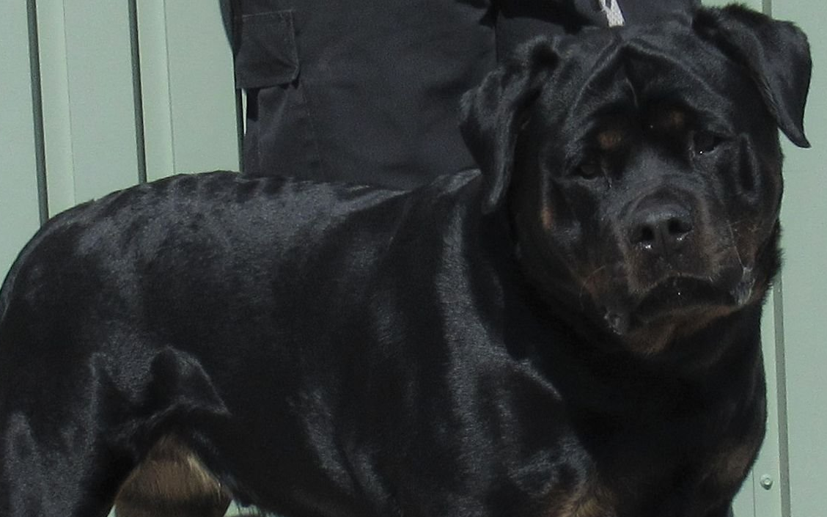
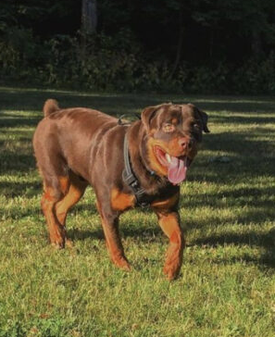

Disqualification
Absence of Markings
Any Base Other Than Black
Notes:
I'm sorry, I can't seem to get the blue outline on the box

Slide 38
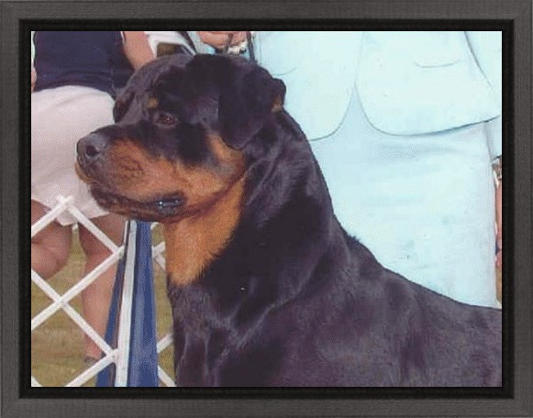
The neck is moderate in length, moderately arched and strong.
Neck
The length of neck is essential to the correct profile of the Rottweiler.
The neck must be slightly arched, muscular and strong to carry the head. Throatiness means too much skin hanging around under the neck and is not desirable. You want to see a "clean dry outline.”

Slide 39
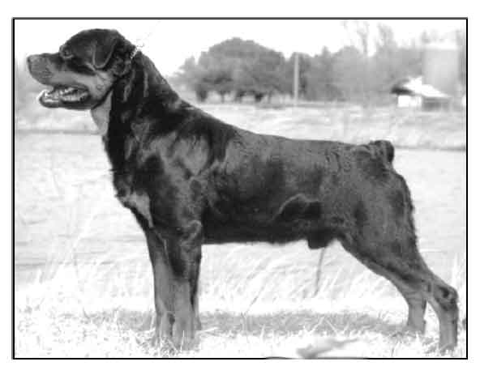
Length of Neck
Easy trick: Draw an imaginary line from the bottom jaw along length of body. If the line is above the top line, the length of neck is correct. If it meets or is close to the top line, the neck is too short in length.
Notes:
Crap! I was doing an edit when text disappeared. I wrote from memory but it may need to be fixed.

Slide 40
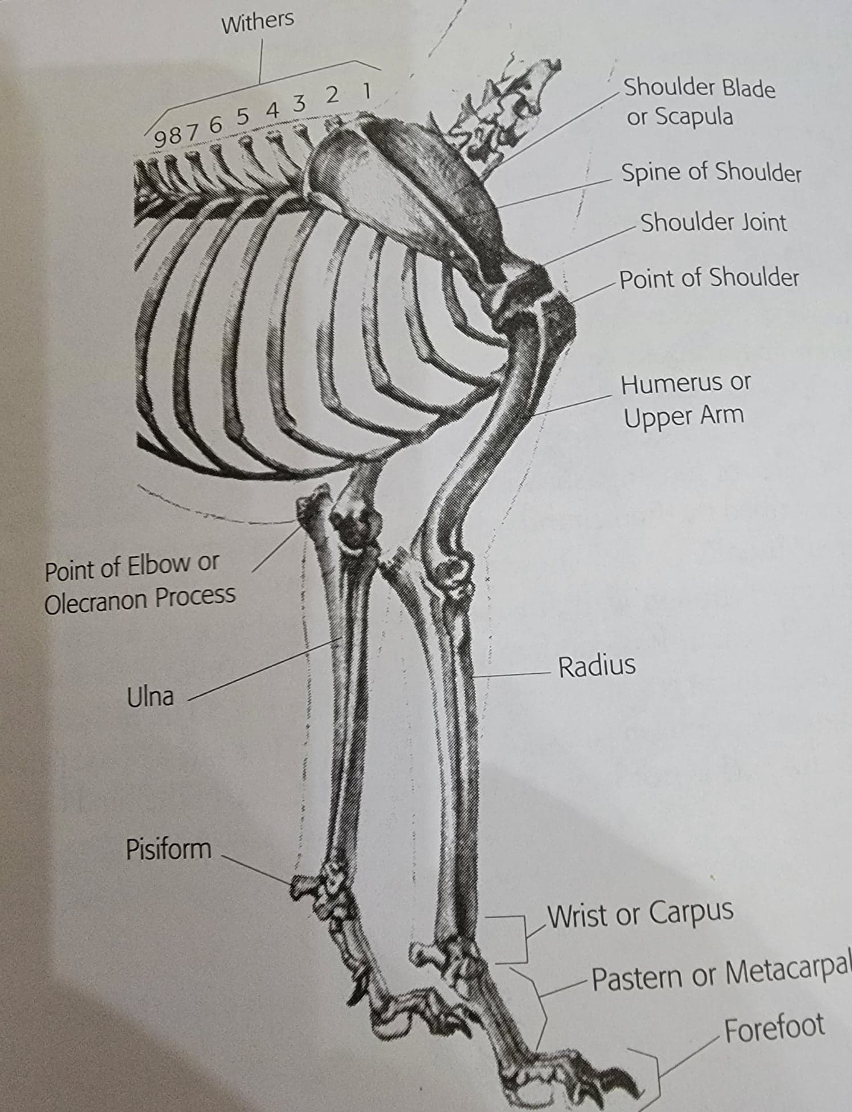
Forequarters
Shoulder blade is long and well laid back.
Upper arm equal in length to shoulder blade, set so elbows are well under body.
Distance from withers to elbow and elbow to ground is equal.
Legs are strongly developed with straight, heavy bone, not set close together.
The Forequarters is made up of the shoulder blade, which articulates with the upper arm at the shoulder joint; the upper arm, which articulates with the forearm; the forearm, which consists of the radius and ulna, the wrist, consisting of seven carpal bones; the pastern, consisting of five metacarpal bones; and the forefoot.

Slide 41
Front Angulation
The forearm is straight when viewed from any direction.
The pastern is springy and strong, almost perpendicular to the ground.
The feet are round and tight, with well arched toes.
Nails are strong, short and black.
Viewed from the front, the Rottweiler should never be narrow.
Chest must be well developed.
Legs should not be bowed or out at the elbows.

Slide 42
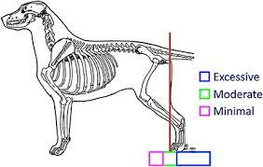
Shoulder Angulation
A well laid-back shoulder approximately forms a triangle.
The distance from the withers to the point of shoulder should
be approximately the same as the distance from the
shoulder to the elbow.

Slide 43

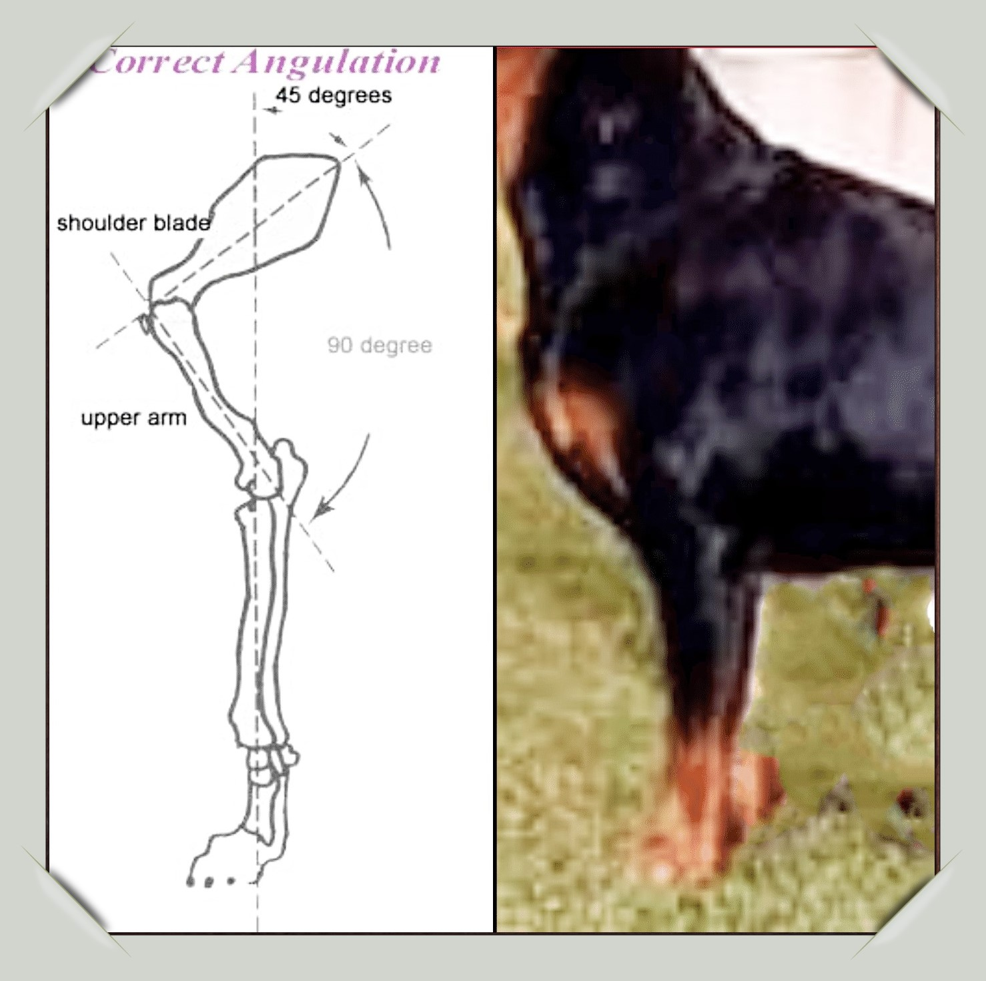
Shoulder Angulation
Shoulder blade is long and well laid back.
Upper arm equal in length to shoulder blade, set so elbows
are well underneath body.
The chest is
broad and deep.

Slide 44
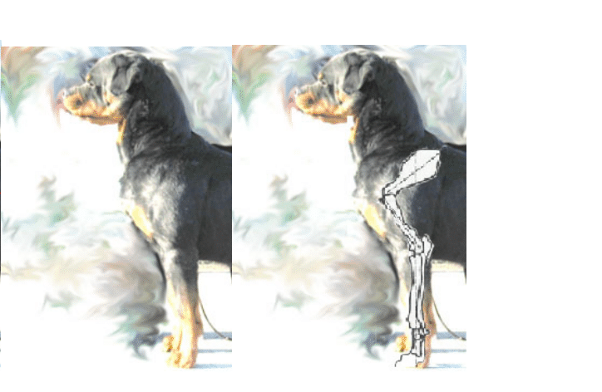
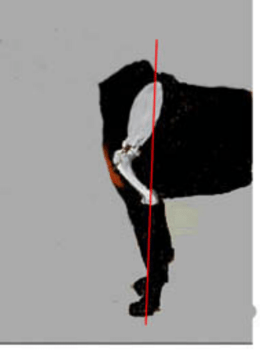
Correct
Note: If the shoulder blade is forward and upright, you may still have forechest. Hence, just because a dog has forechest does not mean it is correct.

Slide 45
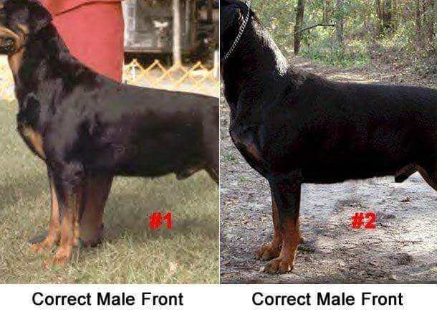
Female Male

Slide 46


Front Assembly
Note forechest
Note indent
Legs perpendicular to the ground along with
elbows that are tight against the body

Slide 47



Upper arm too far forward
In a straight front, the upper arm sits in front of the rib cage.
No indentation.
No forechest.

Slide 48


Straight Shoulders
Note wrinkles over the shoulders which may indicate a straight shoulder
Notes:
Not sure why there's a frame on the one photo?

Slide 49

Wide in Front
No support

Slide 50


Upper Arm
Length of upper arm (humerus)—You
can assess length of upper arm by
using three reference points that
can be easily located:
The top of the dog’s shoulder
The point of the shoulder
The tip of the elbow

Slide 51
Correct upper arm

Slide 52
Upper Arm
A shorter upper arm in relation to the scapula is becoming a common structural problem in the Rottweiler, causing a movement fault where there is typically less-than-optimal reach when trotting and less convergence toward the centerline.
If the upper arms are not supported properly by the body, the lack of support will cause an instability and a lack of strength in the front assembly.

Slide 53

Straighter
Correct
Length humerus
Short
humerus

Slide 54

Shorter Upper Arm

Slide 55


upper arm
The upper arm can be too far forward and actually sit in front of the ribcage

Slide 56


Topline
Topline is formed by the withers, back, loin, and croup.
This is the area from the base of the neck to the base of the tail.
Preferred topline is level, meaning that this area should be flat and strong.

Slide 57
Topline Problems
Dips at the withers or softness in the topline indicate there is something wrong with the structure of the front assembly.
A rise in the rear of the topline indicates that there is something wrong with the structure of the rear assembly.
A sloped topline indicates some type of imbalance in the structure front to rear.

Slide 58



Topline problems
Slope in topline:
Front angulation does not match rear angulation
High in the rear
Roach
Low tail set

Slide 59

Too Short in Back
A square dog with a shorter back…the dog will fit a square
While this dog is nice and short back, as breeders we must be careful
not to change the balance of the profile.
A dog that is too short in back will not move correctly. He needs to be slightly longer in back; Otherwise, he will overreach.

Slide 60

Long in back
This bitch is long in back,
Low on leg…the two often go
together
Long and low decreases length of stride and speed.

Slide 61





Bitch Pictures
22 inches to 25 inches
Bitches are distinctly feminine.
Serious faults: Lack of proportion, undersized, oversized
Reversal of sex characteristics (bitchy dogs, doggy bitches)

Slide 62





Dog Pictures
Dogs 24 inches to 27 inches.
Dogs are characteristically more massive throughout with larger frame and heavier bone than bitches.
Serious Faults - Lack of proportion, undersized, oversized, reversal of sex characteristics (bitchy dogs)

Slide 63
Loin
The length of a correct loin should be no more
than one third the length of the ribcage.
If there is any topline issue due to the front
or rear assembly, a longer loin will intensify the problem
Short loin makes the spine stiffer and less flexible.

Slide 64

Loin

Slide 65

Correct length of Loin

Slide 66

Loin Problems
Long in loin

Slide 67
Croup
The croup is the area from the front edge of the pelvis to the base of the tail.
The length and angle of the croup affects the eventual width of thigh as seen from the side.
The angle of the croup affects the angle at which the hindquarter functions.
Too steep a croup, results in loss of hindquarter drive
Ideally, a crop should be of good length and laid at a gentle angle to the back so that the drive up through the hindquarter flows forward along the back with out a break.
Too steep will reduce the arc of movement that is possible from the hindquarter, resulting in restrictions in drive.

Slide 68

On each side are (1) the ilium, (2) the ischium, and (3) the pubis bones The pelvic bones are joined directly to the three fused sacrum vertebrae by the sacroiliac joint. The angle in which the pairs of bones are attached to the sacrum is called the pelvic girdle slope. This angle varies from dog to dog.
The function of the croup is to determine the “set-on” of the tail. The sacrum and the first several tail vertebrae form the croup (see Figure A).
The angulation of the croup determines the tail set.
If the croup is flat or level, the tail set will be high.
If the croup is gently rounded, it becomes a continuation of the backline and the tail usually continues the level of the spine, carried horizontally to the ground.
If the croup is angled downward, the tail set will be low. The steeper the downward angle, the lower the tail set will be on the dog.
The angulation of the croup is dependent upon the curvature of the individual sacral and tail vertebrae.
A
1
2
The extremity of the pelvis (ischium (2), if it extends well to the rear, gives greater area for attachment of the rear muscle.
3
B

Slide 69


Steep Croup
Too steep or too rounded croup (and/or low tail set)
If the croup is steeper or rounder than what is required, the problems is coming from beneath it. The more dogs carry or position their rear legs under them, the more the croup will drop or round. The more structural issues a dog has with its rear legs, the more pronounced the effect of the croup.
Correct Croup

Slide 70
Hindquarters
Angulation of hindquarters balances that of forequarters.
Upper thigh is fairly long, very broad and well muscled.
Stifle joint is well turned. Lower thigh is long, broad and powerful with extensive muscling leading into a strong hock joint.
Rear pasterns are nearly perpendicular to the ground. Viewed from the rear, hind legs are straight, strong and wide enough apart to fit with a properly built body.
Back feet: are somewhat longer than the front feet, turning neither in nor out, equally compact with well arched toes. Pads are thick and hard. Nails short, strong, and black. Dewclaws must be removed.

Slide 71
Angulation of the hindquarter usually refers to the relative lengths of the upper and lower thigh, length of hock and the resultant turn of stifle.
Balance comes from equal lengths of upper and lower thigh. Stability - comes with short strong hocks combined with equal lengths of upper and lower thigh.
Instability comes from increasing length of lower thigh in relation to upper thigh, particularly if combined with long hocks.
Croup – length and lay of croup affects the transmission of power forwards.
Good angulation – equal lengths of upper to lower thigh, ideally with short strong hocks, good turn of stifle.
Over angulation (deep) – too long in lower thigh relative to upper thigh, often with long hocks, excessive turn of stifle.
Lacking angulation - short upper thigh, longer lower thigh, slight to moderate turn of stifle; usually combined with long hocks and short steep croups.
Straight – very short upper and lower thigh, straight stifle, hocks short and very little deviation from the line of the hindquarter.

Slide 72


The ideal angulation is where the length of the femur is equal in length of tibia/fibula (lower thigh)
The longer both the femur and tibia/fibula are the greater turn of stifle.

Slide 73
Rear Angulation
The rear assembly is muscular and matched to it in lengths and angles.
The thigh is well-developed, stifle well bent and hock both short and well let down.
The rear feet are like the front feet except that they are somewhat longer than the front feet
A Rottweiler should not be extremely angulated, appearing long-legged in the rear.
The breed’s athletic skills in jumping, as in agility competition, are dependent upon a strong rear.

Slide 74

Rear Angulation
Rear angulation is a term that is misunderstood by many. It refers to the angles made by the upper thigh with the pelvis and lower thigh, and the lower thigh (below the stifle or knee) with the metatarsus, commonly called the hock. The standard calls for a “well-bent stifle”, which means there should be a noticeable change in direction (but not extreme) when your eye or hand follows the front profile of the back leg from the abdomen around the stifle to the hock.
Noticeable change in direction

Slide 75


Correct Rear
When the rear is correctly angled you should be able to drop
a line from the point of the buttocks to the rear toes.

Slide 76

Extreme rear angulation
The farther behind the line that foot is, the more stress there will be on the
stifle, hock and hip joints.

Slide 77


Straight in stifle
Note, high in the rear
Straight stifle causes
stress in the middle
of the back

Slide 78
The ideal angulation is one where the length of the femur is equal to the length of tibia/fibula (lower thigh).
A quick way to check for equal lengths of femur and tibia is to raise the hock (perpendicularly) up to the end of the pelvis. If the point of the hock extends beyond the rear edge of the pelvis, then the tibia is too long in relation to the femur. Rarely if ever is the femur too long.

Slide 79

Tail
Docked, the tail is short, close to the body leaving one or two tail vertebrae. Undocked, the tail is carried straight or upward curved and may hang at rest.
Faults – Tails with kinks, strong lateral deviation, or ringtails.

Slide 80


Docked

Slide 81


Undocked

Slide 82
Feet
Feet are round, compact with well arched toes, turning neither in nor out. Pads are thick and hard.
Nails short, strong and black. Rear dewclaws must be removed.

Slide 83

Correct Feet

Slide 84



Feet: Problems
Flat feet
Toes out

Slide 85
Pasterns
Pasterns are strong, springy and almost perpendicular to the ground.

Slide 86
Pasterns
Pasterns work together with a dog’s paws to “shock absorb” the impact of running and jumping while providing flexibility of movement. Those parts, however, are only as good as the rest of the dog’s structure.
Pasterns bear the burden of a dog’s shoulders and hindquarter assembly as he moves, and if the rest of the dog is built poorly, it’s all going to make a dog tire faster.
A “straight pastern” can absorb most energy, but a small angle is desirable to ensure that the dog’s joint doesn’t knuckle over on impact.
Poor pasterns can be inherited, but there may also be environmental factors: A bad diet and obesity can cause down in pasterns.
In developing puppies, teething and trauma may also come into play. Puppies raised on a concrete surface or who aren’t getting enough exercise can be also be susceptible.

Slide 87


Pastern
Strong, almost perpendicular
to the ground.
Straight
pasterns
Weak pastern,
down in pastern

Slide 88

Strong hock joint
Lower thigh is long, broad and powerful, with extensive muscling leading into a strong hock joint.
Long pasterns tend to go with increased size of the dog and a straighter hindquarter.
Shorter pasterns are more desirable, as they go with better turn of stifle, and greater firmness of hocks, for better transmission of drive.

Slide 89
The hock is a joint. It has an angle but no length.
So, when we talk about long Hocks what we’re really
talking about is long pasterns.
Pasterns have a length as do upper and lower thighs.

Slide 90



Sickle Hocks
A sickle hock is one where the hock is bent at more than 90 degrees to the ground when viewed from the side. This curved hock gives the appearance of a sickle. Often this hock cannot be flexed in action.
Second thigh too long
Hock Angulation too acute
Sickle hocks are easily seen on the backward swing of the rear leg during movement. Instead of the joint between the lower thigh and the hock opening into a nearly straight extended line, where the pads on the bottom of the foot end in a position that is nearly straight up (or reaching toward the sky), the sickle hock, due to the imbalanced length of the bones (longer lower thigh), at fullest rearward extension ends in a shape resembling a sickle – slightly curved instead of fully extended. The rear movement on the sickle hocked dog looks like the swinging of an old fashioned sickle when viewing the sickle from the side.

Slide 91


Sickle Hock
Sickle hocks create a
lack of rear power, which
impedes running and jumping
as well as a lack of rear-
assembly stability for quick turns.
when a dog can't hold the hock perpendicular to the ground while stacked and always has the toes in front of the hocks no mater how far the leg is taken backwards, you have sickle hocks, and it is quite noticeable from a stacked photo.
At times you may see the handler having problems setting up the dog's rear attempting to put the pasterns perpendicular to the ground, but because the dog does not feel comfortable standing in that position for a long period of time. Often, the dog will try to sit or move its rear legs.

Slide 92
Cow-hocks
The cow-hock trait is genetic
Cow hocks are characterized by the inward rotation of the hocks, causing the points of the dog’s hocks to be closer than normal.
Any puppy who is born with cow hocks, whether they be mild or severe, is automatically carrying a conformation fault with them. Deliberately breeding with this trait can exacerbate the severity and resulting health risks that come with the most severe cow hocks.
Dogs that stand but do not move cow-hocked are not actually Cow-hocked. These dogs have another issue that creates the illusion of cow-hocks (over angulation, long lower thighs, knees out, rear feet out).

Slide 93


Cow Hocked

Slide 94
Balance
Balance is always a governing principle
The efficient use of one body part to balance another minimizes the expenditure of energy and allows for an incredible variety of maneuvers in the dog in motion.
If he must, a dog will make compensatory movements in his limbs if balance is not correct, which appear wasteful of energy, but in fact, are minimizing his expenditure because of anomalies somewhere within that dog.
The best structured dogs have no need of such wasted motion.
Limbs are moved minimally, no farther than necessary from the center of gravity, but
freely and smoothly.

Slide 95

Balance

Slide 96






Balance
Front angulation matches rear angulation
Withers,
highest point
Height
Pelvis
Scapula, shoulder
Equal in
length
Point of Buttocks
Humerus,
upper arm
Femur
Equal in
length
Bend of Stifle
Patella
Point of elbow
Tibia
(Lower thigh)
Radius
Ulna
Body Length
Fibula
Hock joint

Slide 97

Balance
This dog is balanced (straight front and rear), but lacks support, because of steeper angulation front and rear. Also note roached topline.

Slide 98

Measure Balance
To judge balance, draw three lines on your dog. The First
Is a line from the middle of the front leg up past the top of your dog’s head.
The head and neck should be in front of the line.
The second line is from the point of the buttock to the ground. For moderate rear angulation,
The front of your dog’s rear toe should hit the line.
The third line follows the back line forward from the tail out past
The dog’s head (horizontally). Your dogs chin should be above that line.
If your dog passes these three tests, he’s generally balanced and has decent angles.
Measure Balance
1
3
2

Slide 99
Disqualifications
Entropion, ectropion
Overshot, undershot, more than one missing tooth
Unilateral cryptorchid or cryptorchid males
Long coat, any base color other than black, absence of all markings.
A dog that in the opinion of the judge attacks any person in the ring.

Slide 100
Serious faults
Lack of proportion, undersized, oversized
Reversal of sex characteristics (doggy bitch, bitchy dog)
Level bite
Any missing tooth
Yellow (bird of prey) eyes, eyes of different color or size, hairless eye rim
Ear: improper carriage, creased, folded or held away from cheek/head.
Total lack of mouth pigment (pink mouth)
Open coat, excessively short or curly coat, total lack of undercoat, any trimming that alters the length of the natural coat.
Straw colored, excessive, insufficient or sooty markings
Rust other than described in the standard.
White marking any place on dog.

Slide 101
Faults
Wavy coat
Any structural fault that detracts from the described working dog must be penalized to the extent of the deviation.

Slide 102

“Your entire selection process is aimed at selecting the very best of each new generation while taking the lesser ones out of the gene pool.
Do not encourage people to show dogs of yours that do not measure up.
A breeding program is better when a few really good dogs represent it in the gene pool than when it is represented by a wide array of dogs—many of them mediocre—with all of them in the gene pool.
“Your goal is not how many but how good”!
Patricia Craige’s “Born to Win”
EPS
2022
C

